Slide 1
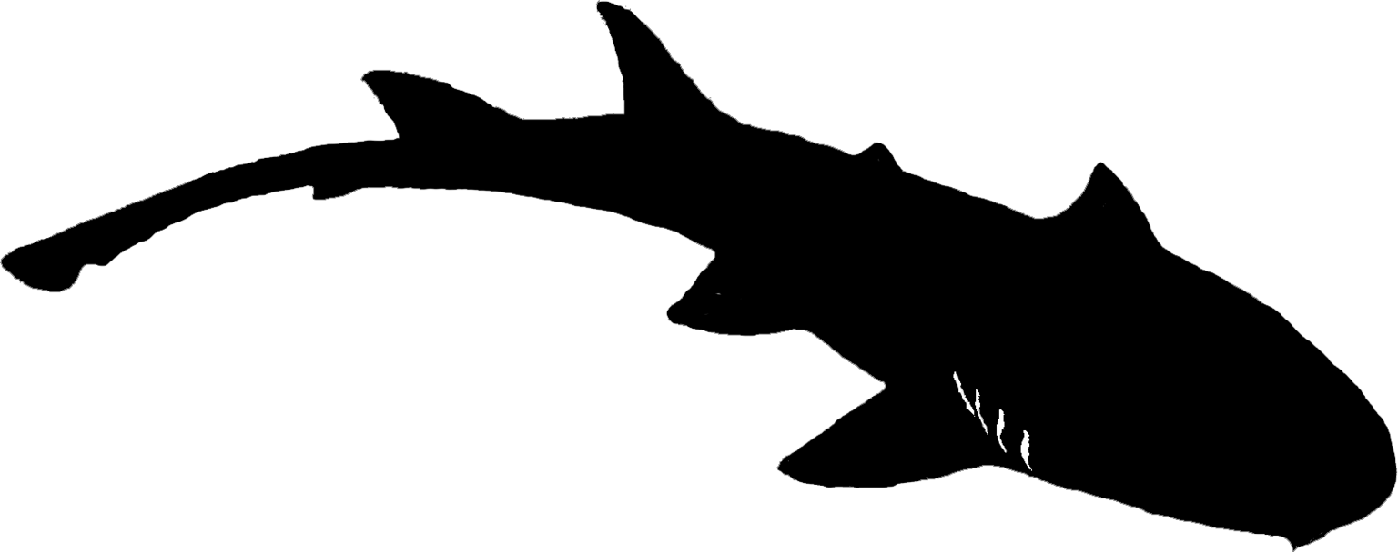




New frontiers in elasmobranch data analysis
Dr Simon Dedman & Dr Guuske Tiktak
Notes:
Simon introduction - Simon specialises in spatial modelling with machine learning, and more recently ecological roles and importance of sharks with structural equation modelling. His background is in fisheries management and policy, but encompasses decision support tools, and behaviour analysis. He's built R packages and is exploring the role of AI as an analysis catalyst.
Guuske introduction - Marine conservation and fisheries biologist, now working as a fisheries consultant she hopes to implement sustainable fisheries worldwide, with an aim to help both people and nature.. She completed her PhD last year in elasmobranch conservation (very broad), but more specifically developing a lab on a chip for shark id in the field, pollutants in sharks, and (not against her will) conducted two systematic reviews with meta-analyses.

Slide 2


Introduction: systematic lit review(s) w/ AI
Propose & review [150] analytical techniques across 8 major elasmobranch research disciplines.
Search those techniques in [12,381] shark papers since 1950 (listed on shark-references.com)
elasmo-only papers = no removing incorrect, non-elasmo results
[iteratively refine techniques with discipline experts]
Plot historical trends: declining approaches, current methods, emerging frontiers
Can run text search queries against all papers. Create updateable databases of:
analytical techniques (by year, by location) [main results today]
researchers’ output (by year, by location, by technique, by discipline)
Network Building: Connect researchers within and across disciplines,
research findings
= Create accessible overviews for practitioners and non-specialists

Slide 3
Introduction: Next steps
Relational database of shark authors
Dynamic interactive map
Who else is working in this discipline, with this technique?
Collaboration, stop reinventing the wheel.
The basis of future review articles (massive timesaver)
(pending performance comparisons against traditional systematic lit reviews)
PhD Chapter 1 accelerant (elasmo only)
Living knowledgebase e.g. ecological roles
Public database (open access)
Share, improve, evolve: AES, OCS, SI, EEA
Notes:
This panel is ‘scratching the surface’ of our bigger picture

Slide 4
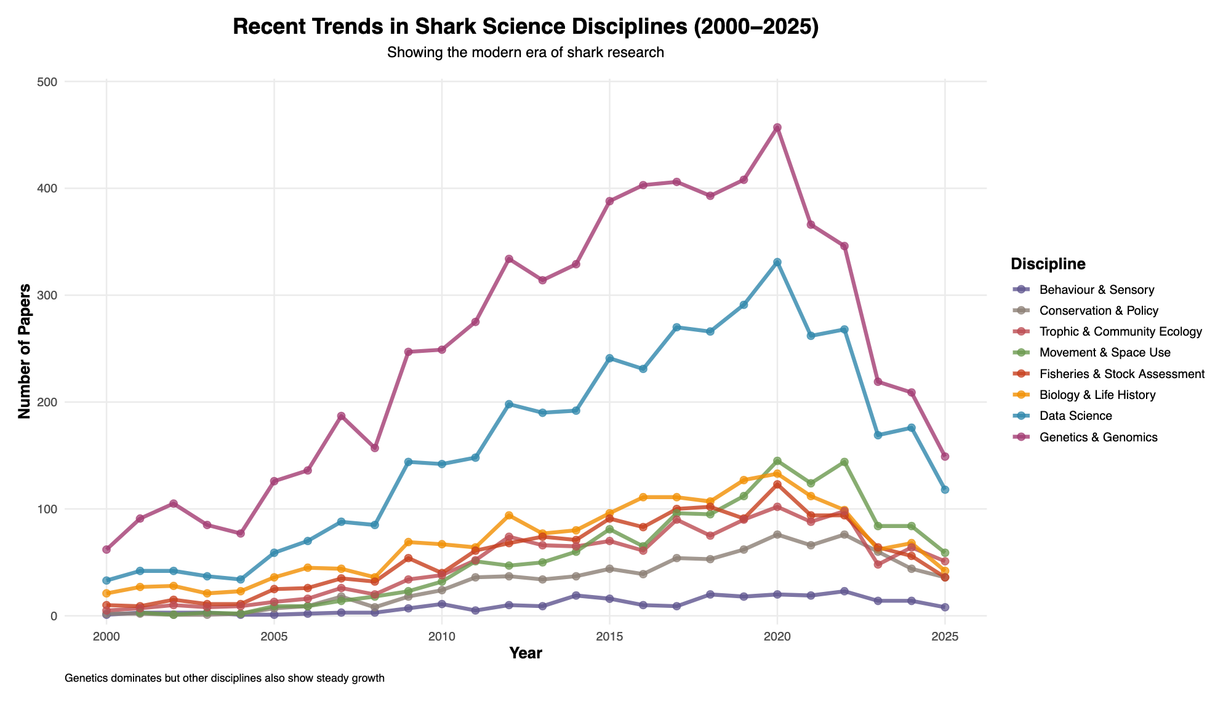
Drop since 2021: papers not yet on shark-references / downloaded
Preliminary results!
Notes:
So here’s some preliminary outputs for papers by discipline; I suspect the drop from 2021 is papers that haven’t been downloaded. YET. They can run but they can’t hide.

Slide 5
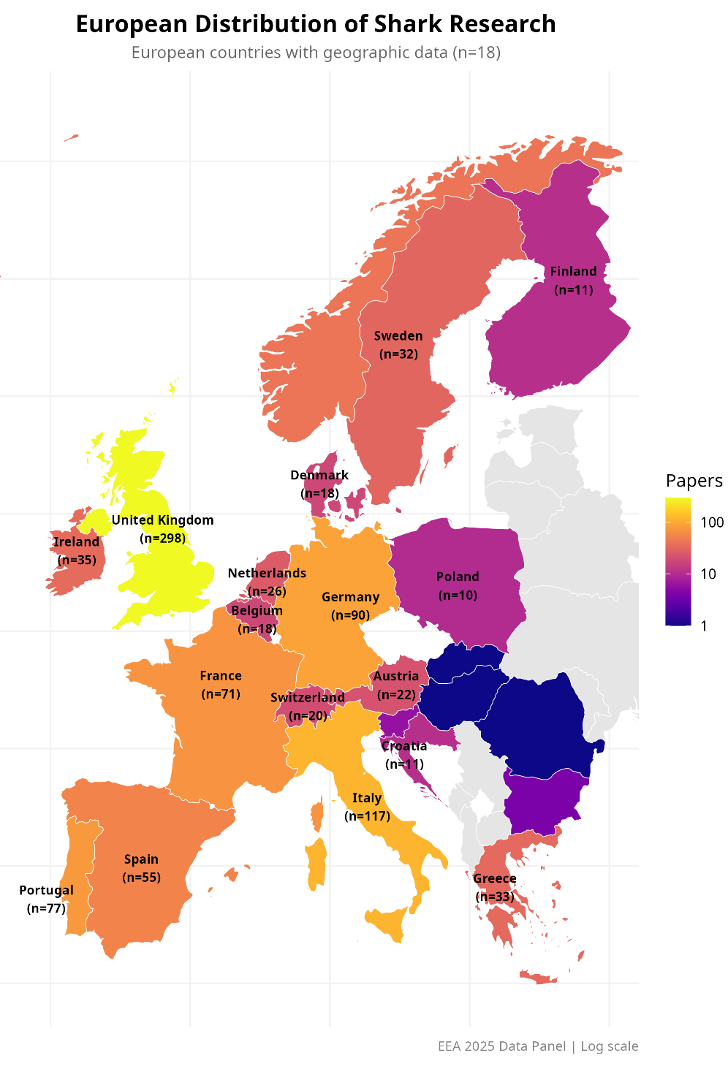
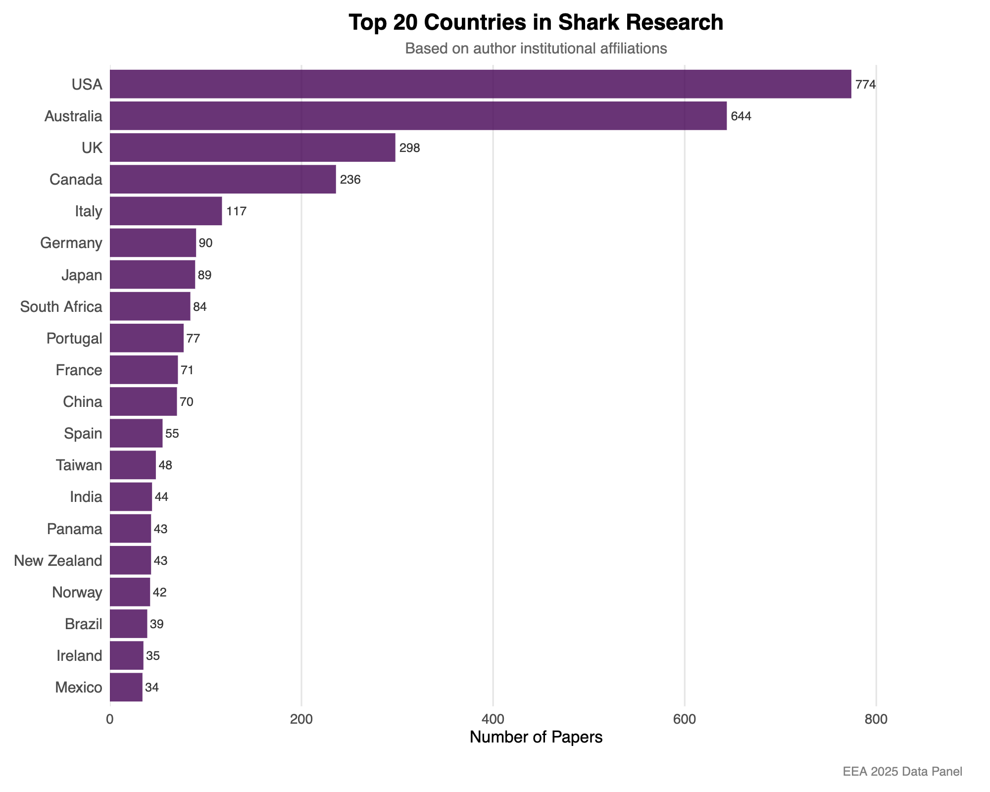
Introduction
Preliminary results!
Notes:
Introduction incl. what the idea is, the aim, the bigger picture, and how the structure of this panel and session will be.
What was the original idea and aim? Bigger picture?

Slide 6
"Physiological Limits and Behavioural Trade-Offs: How Blue shark (Prionace glauca) Adapt to Oxygen-Depleted Waters"
Time for the first talk: 11:20
Amy Jeffries

Slide 7
"Optimising environmental DNA techniques for monitoring bycatch of endangered shark and ray species in the Northeast Atlantic"
Time for the second talk: 11:30
Charlotte Nuyt

Slide 8
"Statistical tools for tracking elasmobranchs and advancing conservation"
Time for the third talk: 11:40
Dr Ed Lavender

Slide 9
"Sharks, rays, and chimaeras reveal a more just and equitable view of global fisheries"
Time for the fourth talk: 11:50
Professor Nick Dulvy

Slide 10
"Trust your model: unbalanced data from rare species does not imply unreliable predictions"
Time for the final talk: 12:00
Maria Dolores Riesgo

Slide 11
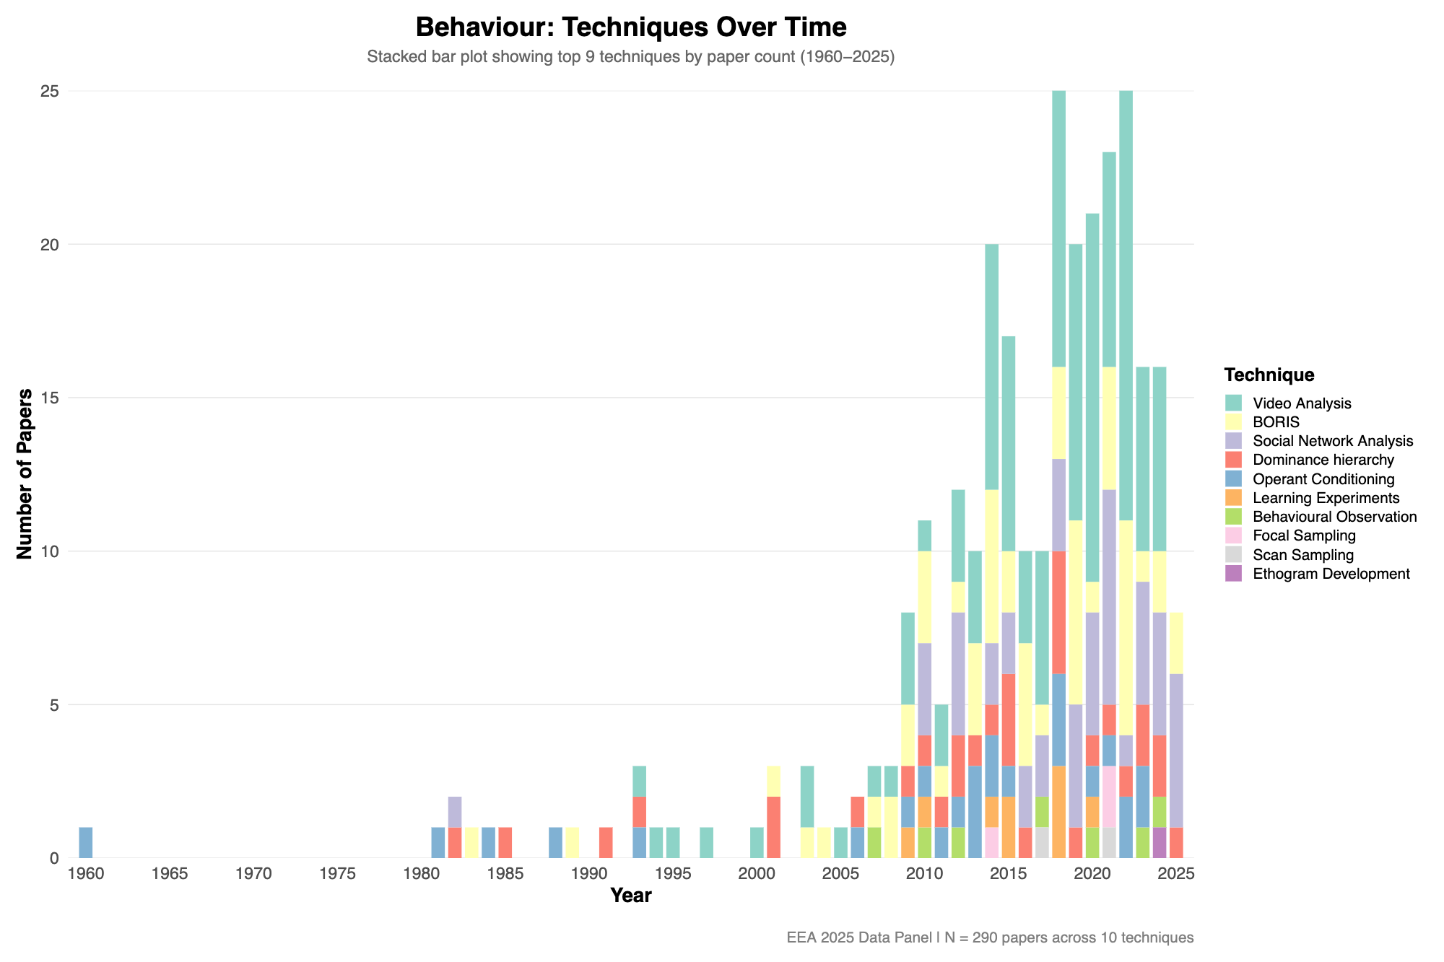
Behaviour &
Sensory Ecology
Preliminary results!
Notes:
Low number of papers, small but growing field, hard/expensive/slow to get data

Slide 12
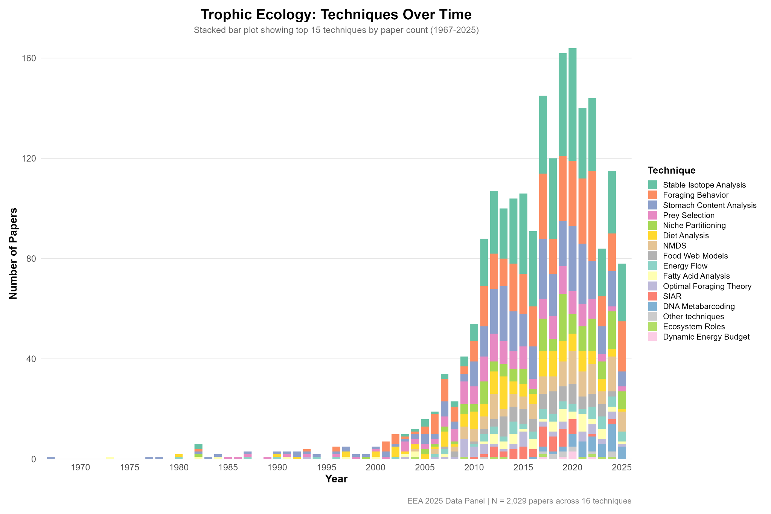
Trophic &
Community Ecology
Preliminary results!

Slide 13
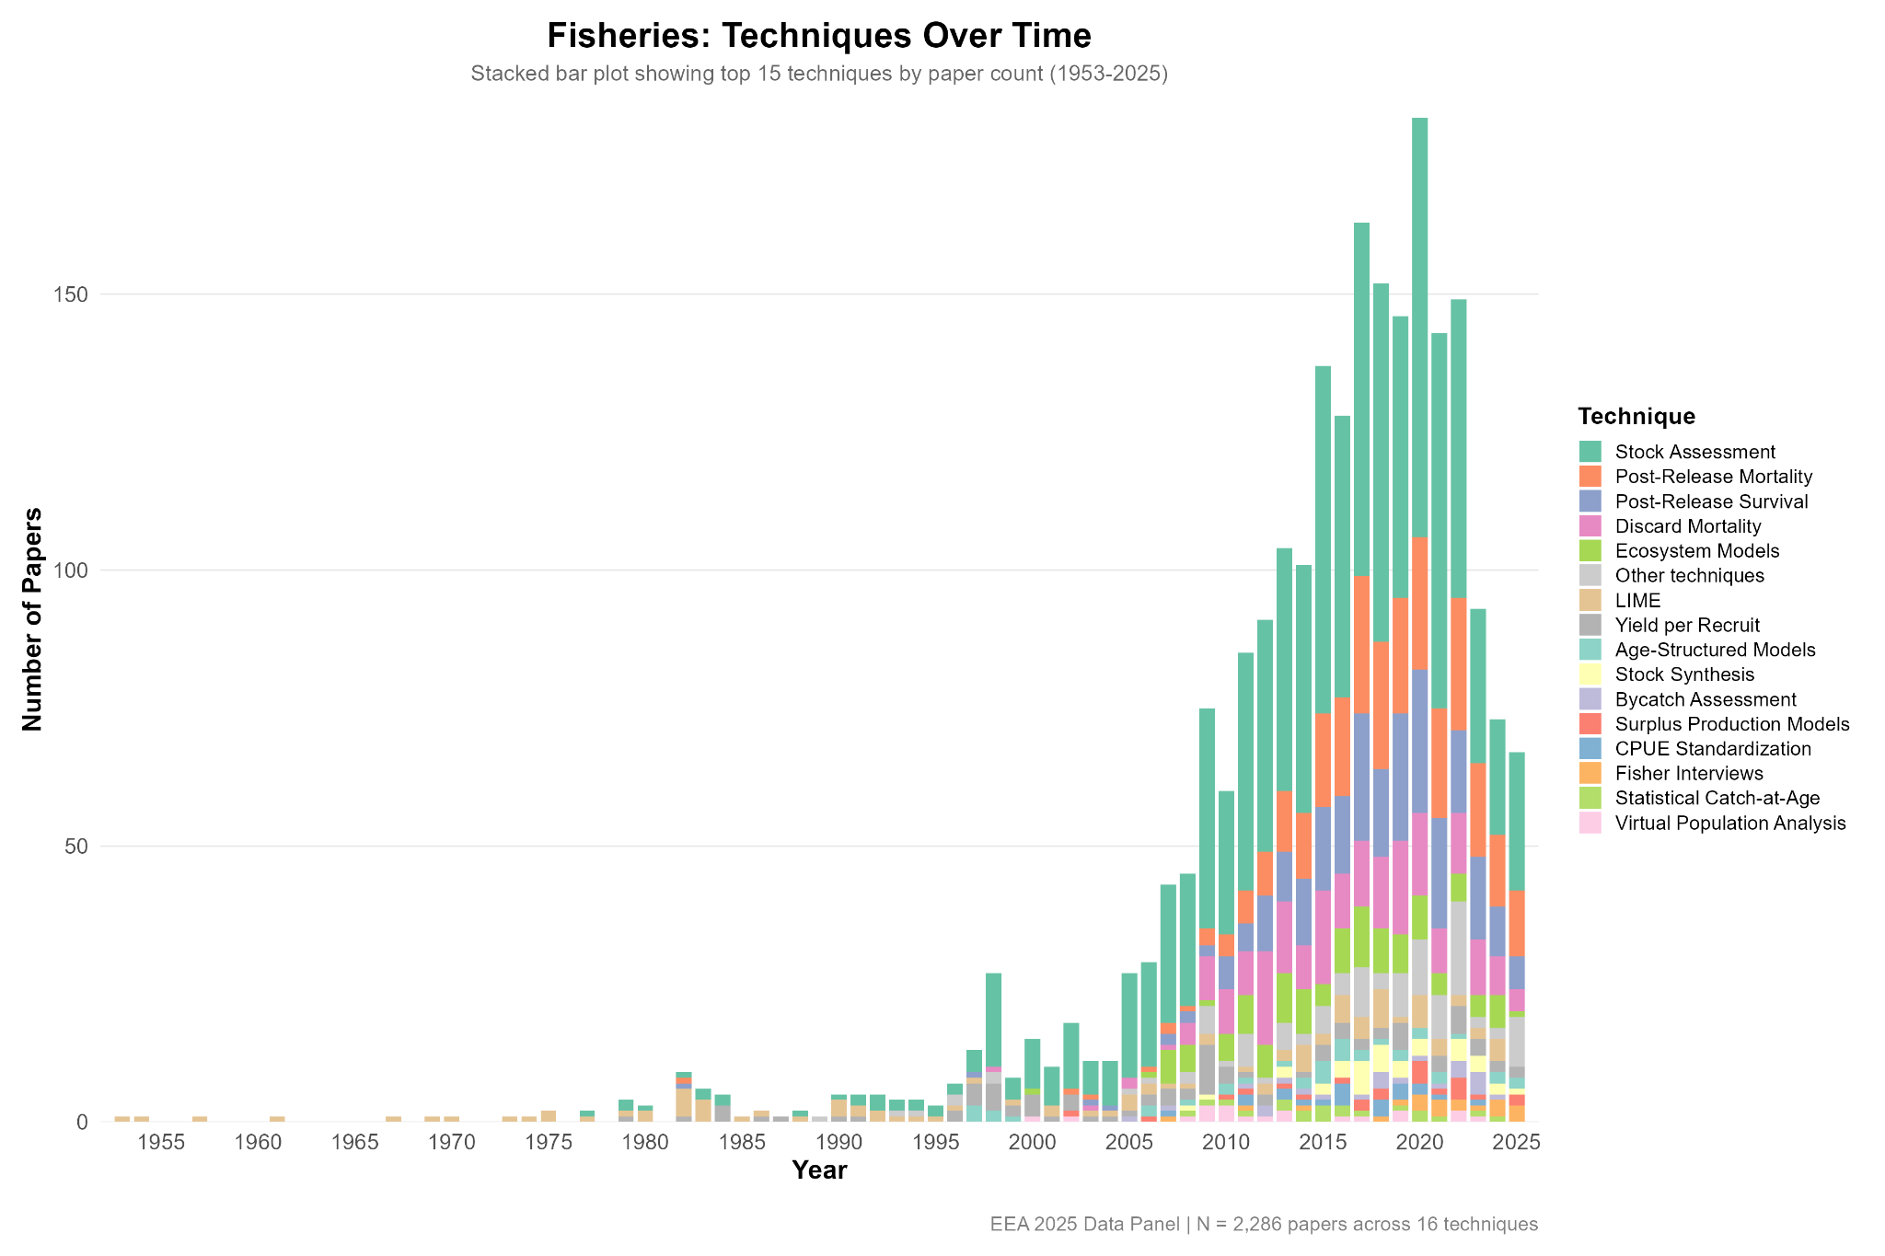
Fisheries,
Stock Assessment,
& Management
Preliminary results!

Slide 14
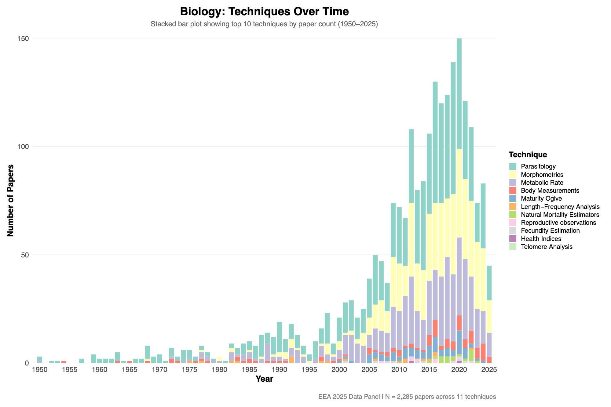
Biology, Life History, & Health
Presented by: Dr David Jiménez Alvarado
Preliminary results!

Slide 15
Biology, Life History, & Health
Introduction
Elasmobranch research has evolved from descriptive to quantitative, predictive, and applied science, driven by molecular and technological innovation.
These advances allow us to address conservation, management, and climate challenges more effectively.
Focus today: emerging techniques, methods losing relevance, and the role of interdisciplinarity & AI in reshaping marine science.

Slide 16
Biology, Life History, & Health
Emerging Techniques
“Omics” tools can reveal how sharks and rays respond to stress, temperature, or parameters changes.
Help identify isolated populations and guide conservation (e.g., Squatina squatina).
Environmental DNA (eDNA) detects species non-invasively from water samples, ideal for rare or endangered species.
Metabarcoding uncovers community structure, trophic links, and ecosystem trends.
3D morphometrics & digital imaging replace manual measures, enabling growth and shape studies without handling.
These techniques also provide early indicators of health, detecting physiological stress or pollution effects.

Slide 17
Biology, Life History, & Health
Overhyped or Developing Tools
AI & machine learning: promising for species ID and modelling, but still limited by data quality and standardisation. AI supports but not replaces expertise.
Traditional Techniques
Age/growth studies and histology remain vital, the backbone of population and reproductive studies.
Now act as complements to modern tools, giving a more complete biological picture: from snapshot to 3D understanding.
Barriers to Implementation
Economic: high cost of sequencing and imaging.
Logistical: limited infrastructure, especially in islands or developing areas.
Training: need for scientists who bridge biology, data science, and policy translation.

Slide 18
Biology, Life History, & Health
For Young Scientists
Balance technology and biology — tools evolve, core questions remain.
Before using a new method, ask: What do I want to know? Is this the best tool?
Promote collaboration & data sharing — essential for migratory species.
Stay curious, critical, and cooperative — science advances through better questions, not just better machines.

Slide 19
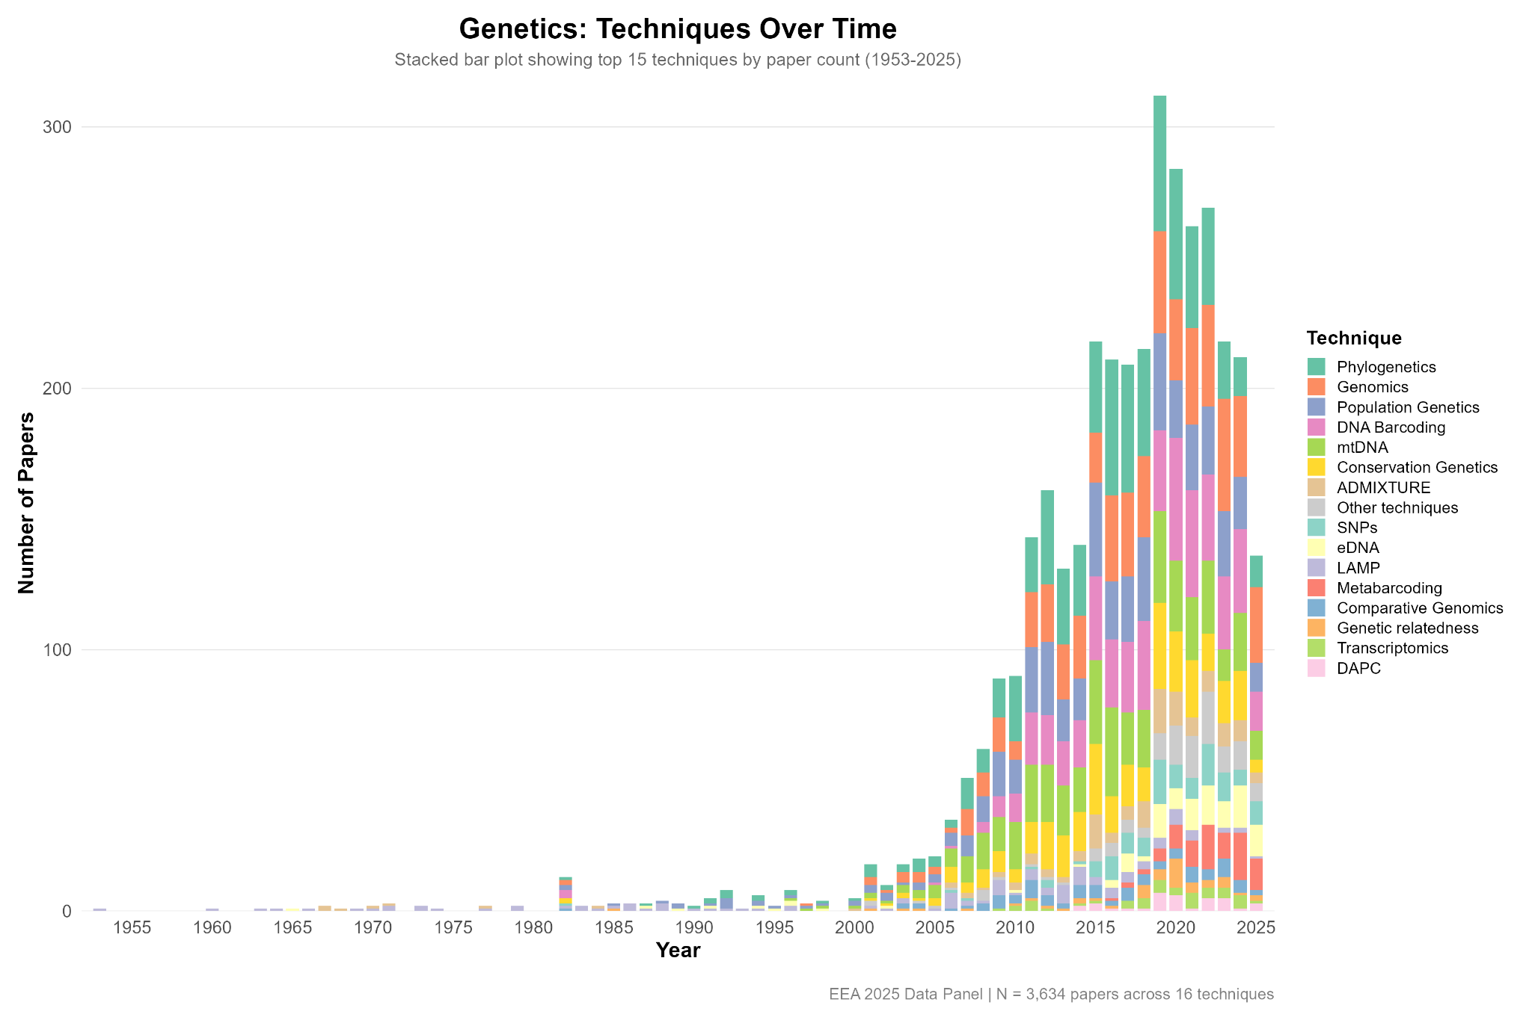
Genetics, Genomics, & eDNA
Presented by: Anouk Langerak & Dr Judith Bakker
Preliminary results!

Slide 20
The emergence of environmental (e)DNA
The widespread adoption and refinement of eDNA metabarcoding
Revolutionizing biodiversity assessments - enabling biodiversity monitoring on very large scales without having to interact with the animals.

Slide 21
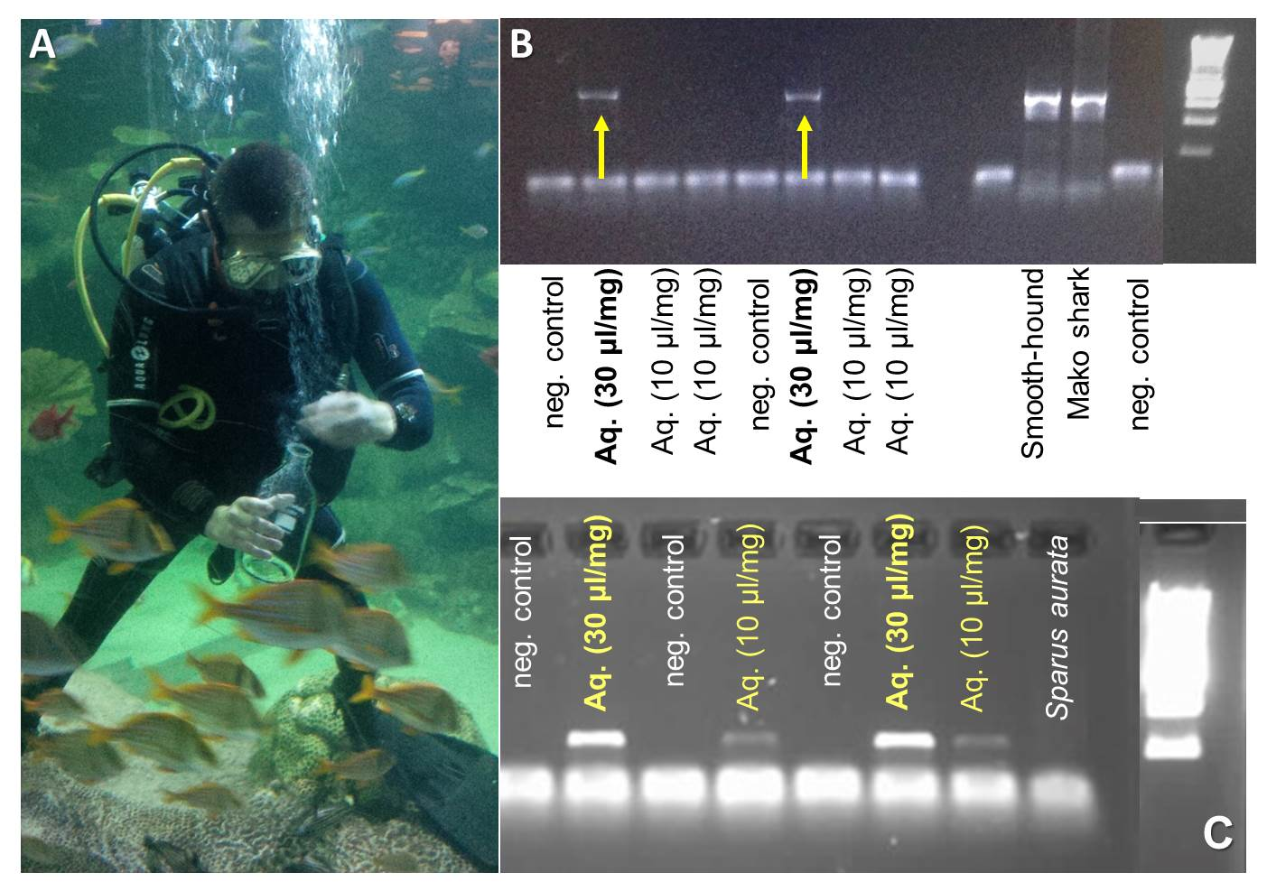

Slide 22
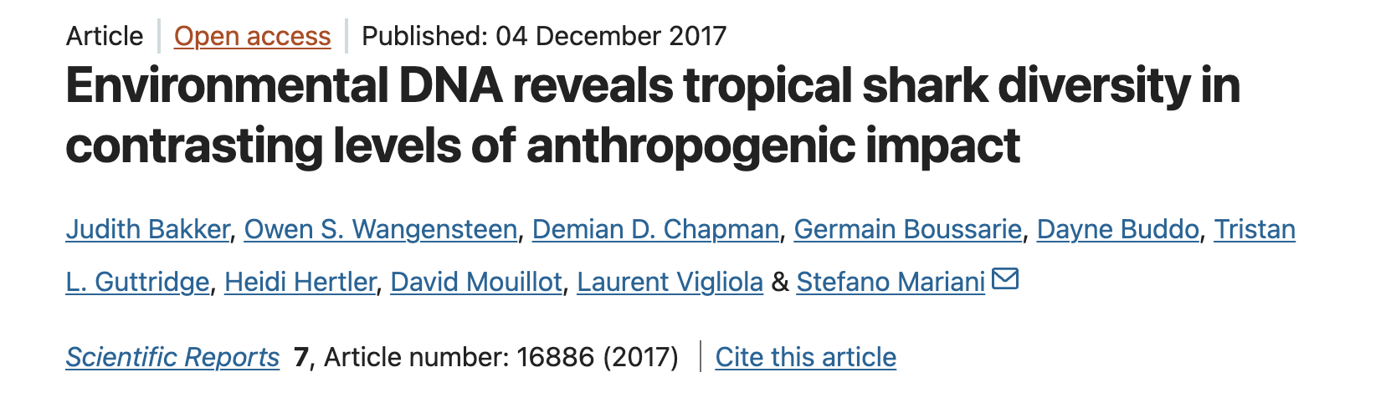

Slide 23
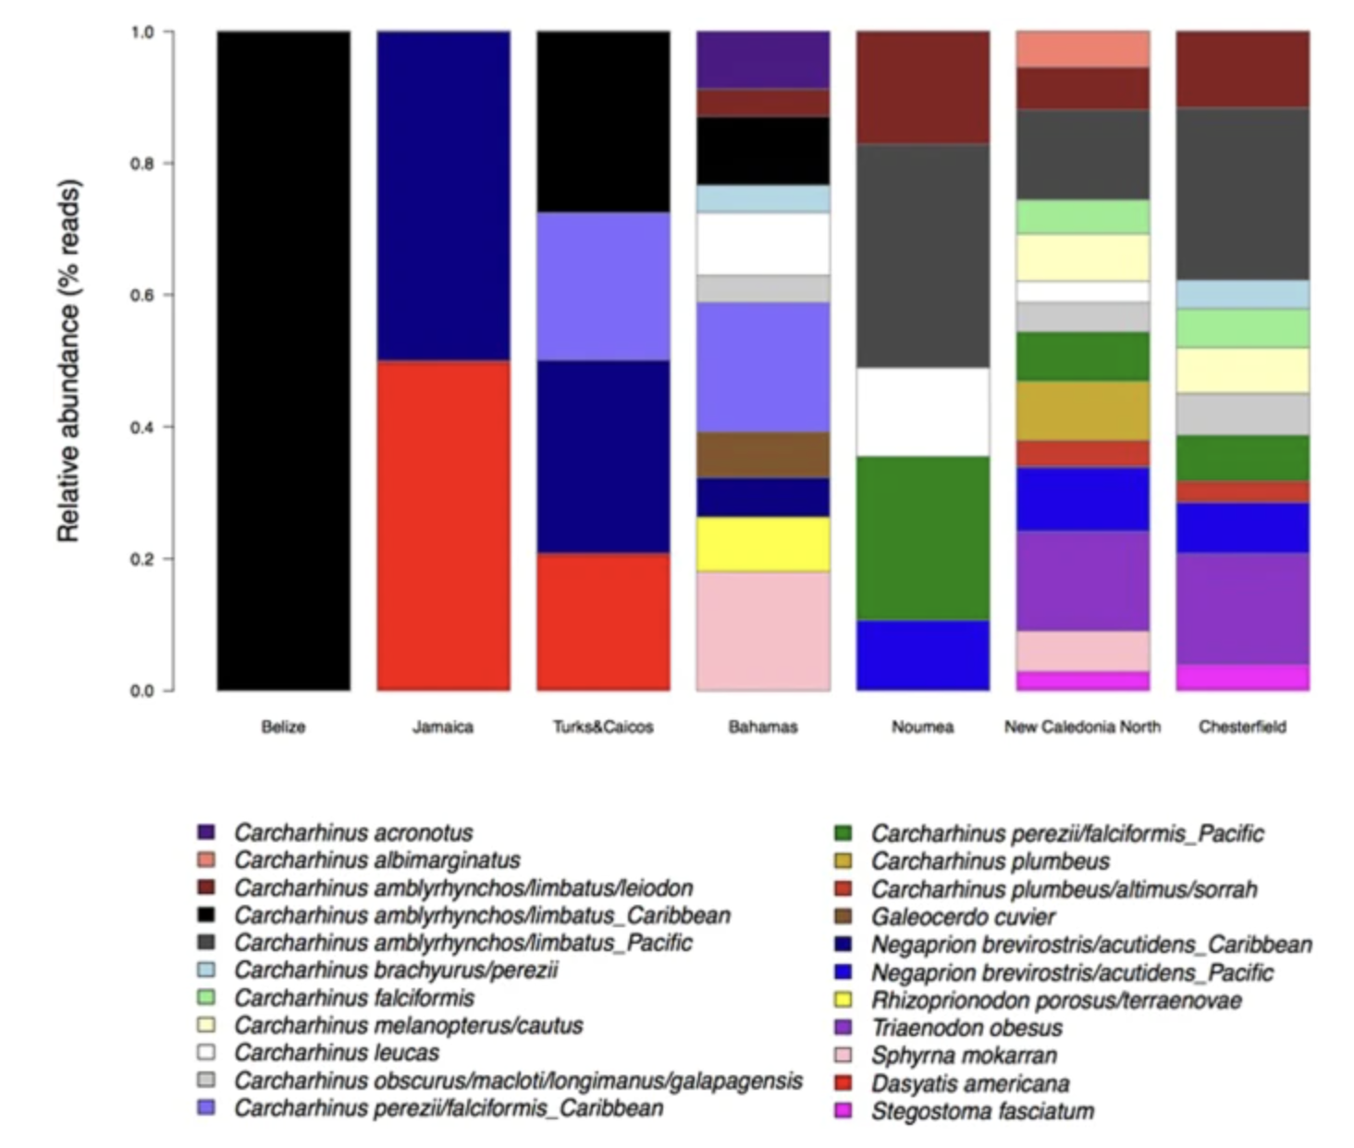

Slide 24
After 2017:>40 elasmobranch specific papers eDNA (meta)barcoding
100s of papers on eDNA metabarcoding in general
Field is expanding quickly
New innovations and applications

Slide 25
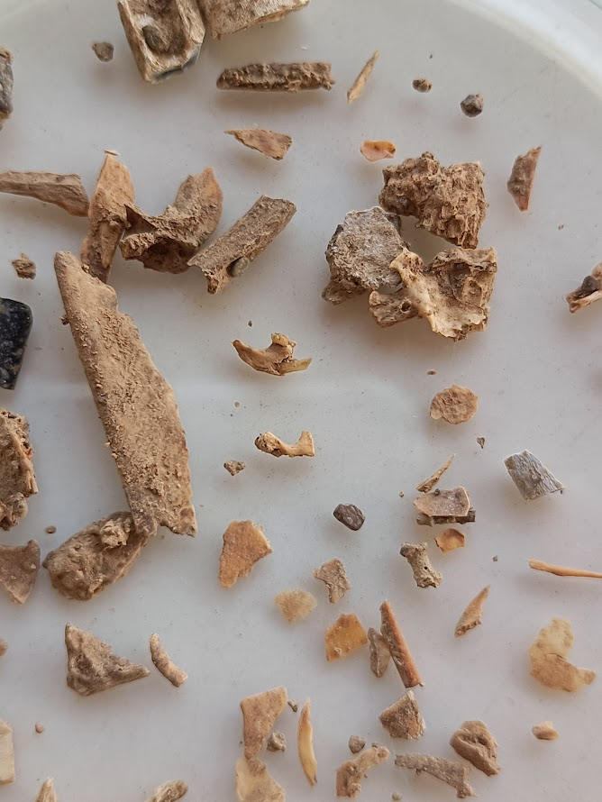
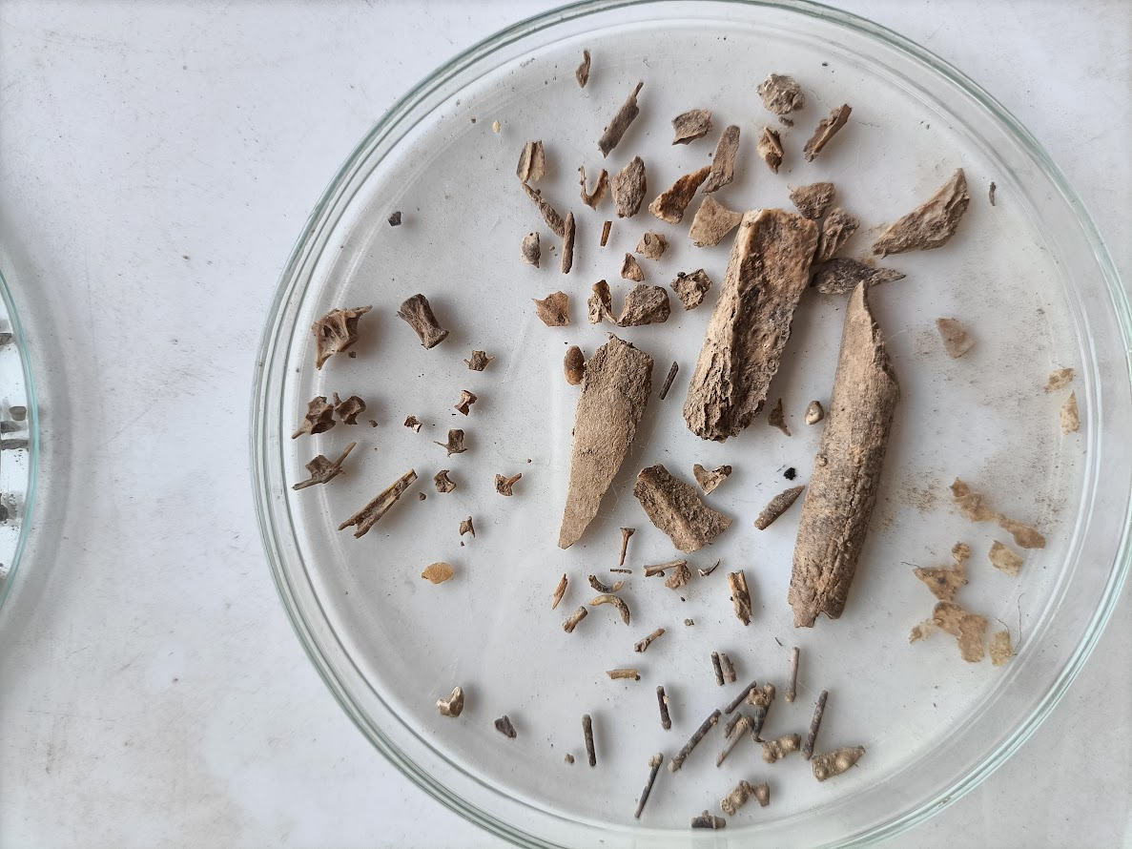
Palaeoproteomics
Presented by: Dr Rachel Winter

Slide 26
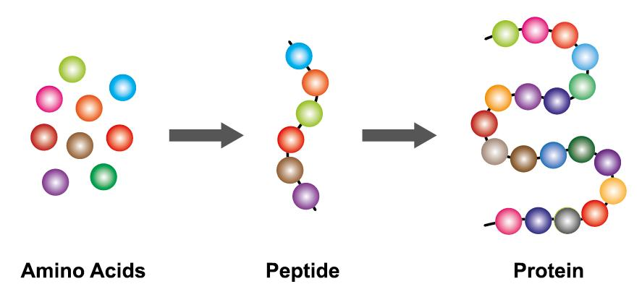
Notes:
This is a bit simplified, but should be helpful for conceptually understanding the next section; the AA we were just introduced to, when bonded together they form a peptide, and several peptides together forms a protein.

Slide 27
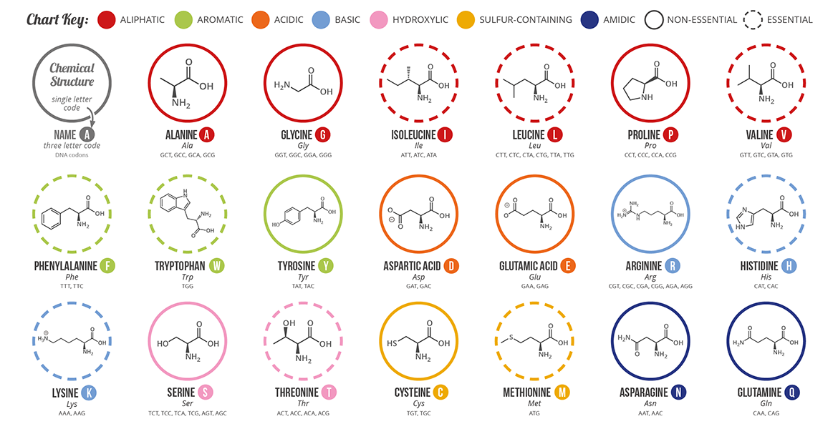
Notes:
A better look at those 20 AA; different categorisations that explain the properties and functions of each AA and these AA **for the most part** have different masses

Slide 28
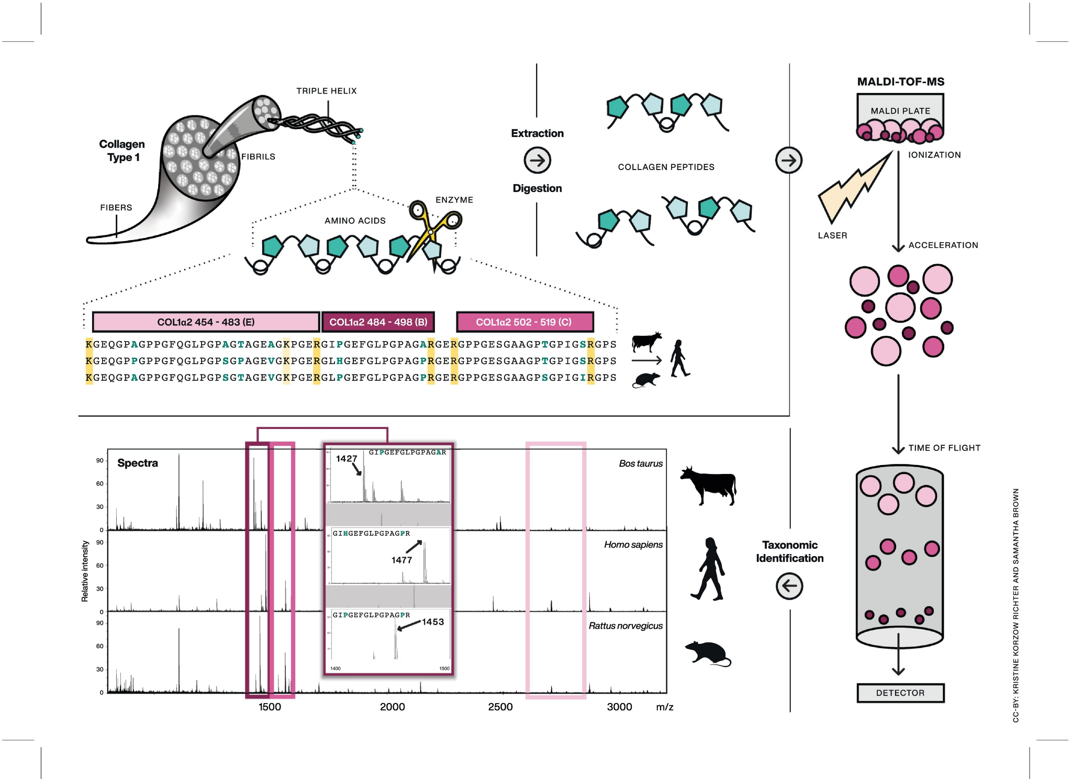
Zooarchaeology by Mass Spectrometry (ZooMS)
Brown et al. (2021) J. Proteomics

Slide 29
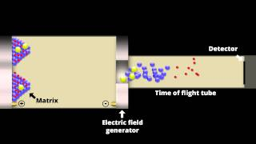
Time of Flight Mass Spectrometry

Slide 30
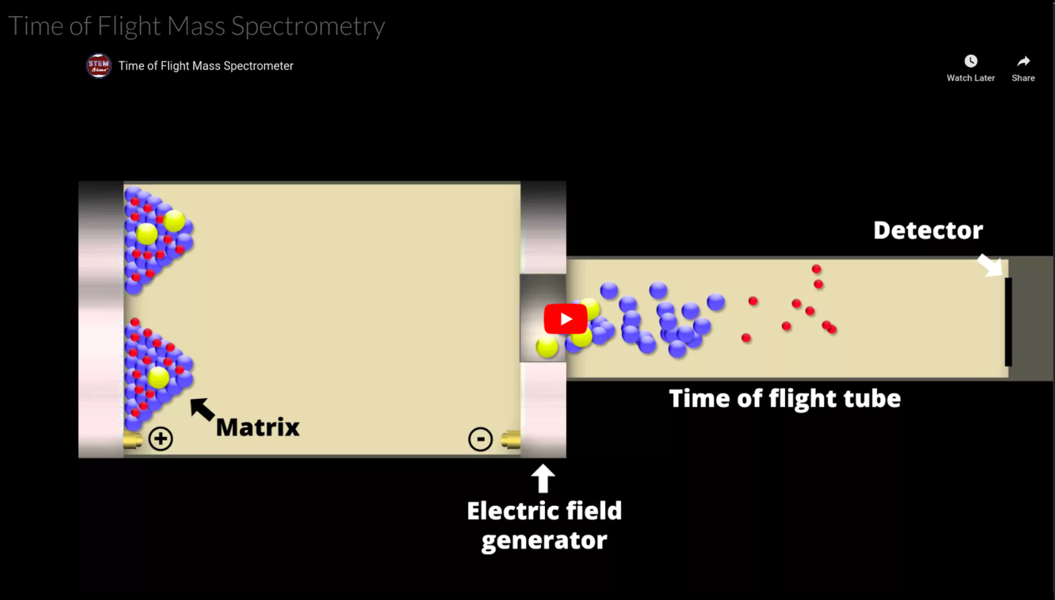
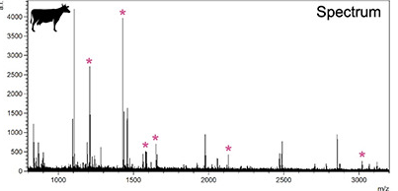

Slide 31
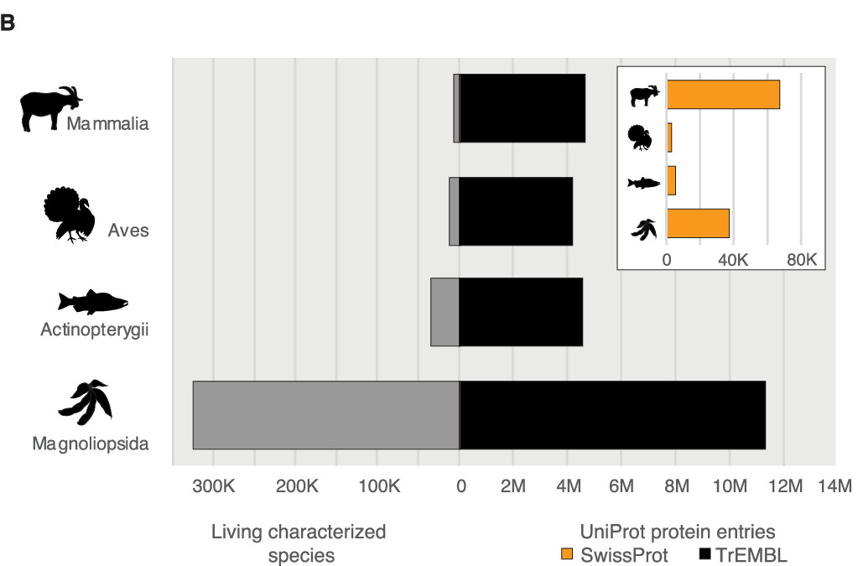
Warinner et al. (2022) Chemical Reviews

Slide 32
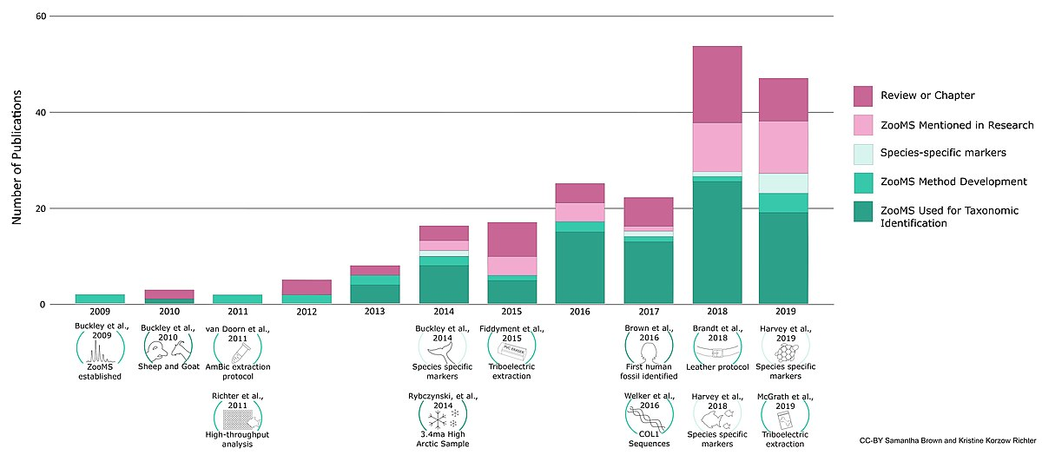
ZooMS applications
Notes:
First published 2009; sheep v goat 2010; first fish 2011; not much work on fish again until more recently.
Marine mammals 2014; reptiles 2019.

Slide 33
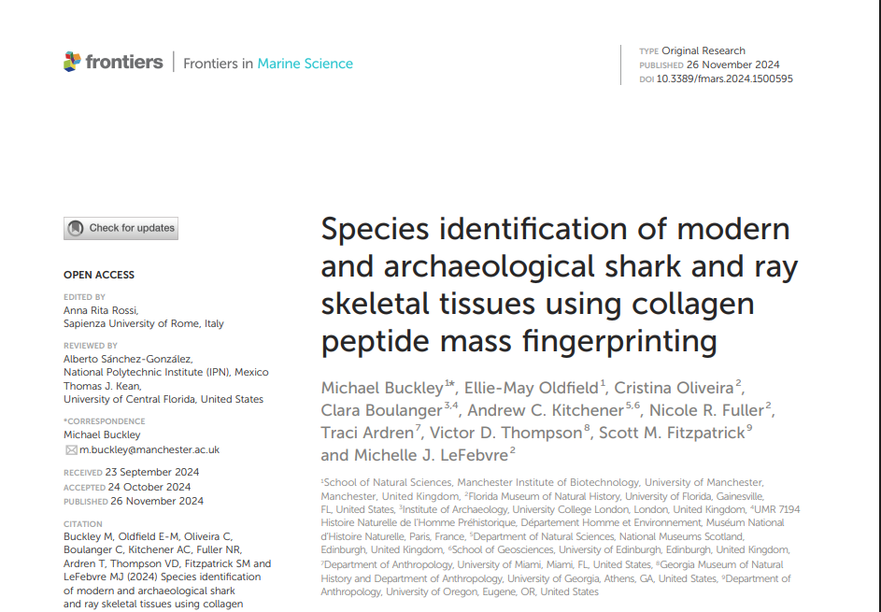
First ZooMS application to elasmobranchs
Notes:
First published 2009; sheep v goat 2010; first fish 2011; not much work on fish again until more recently.
Marine mammals 2014; reptiles 2019.

Slide 34
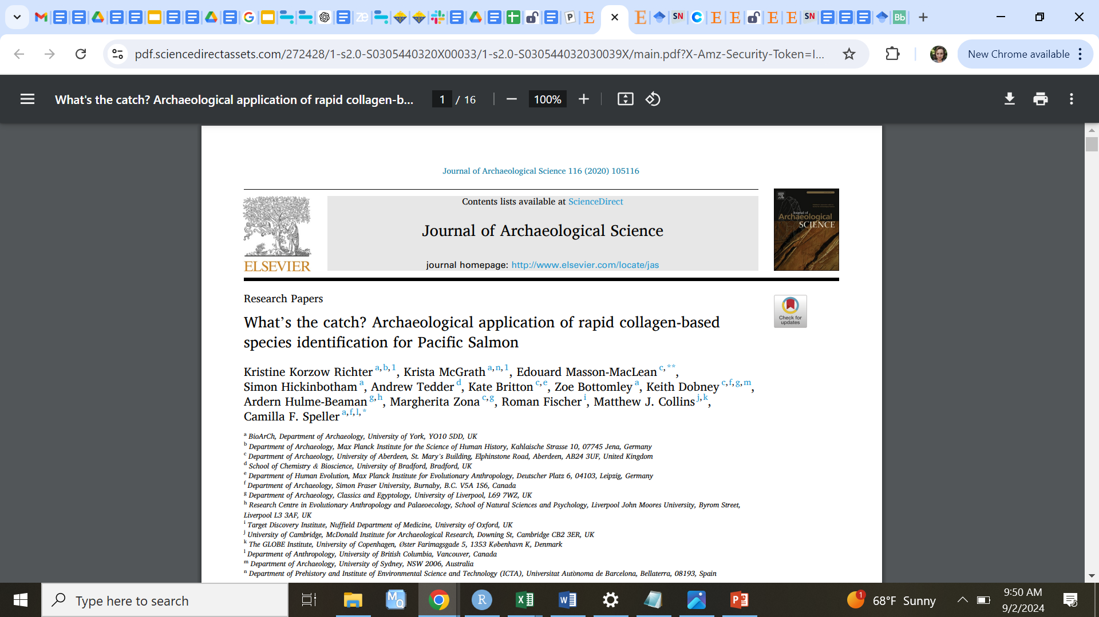
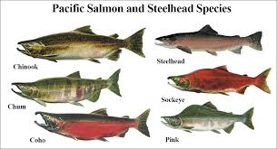
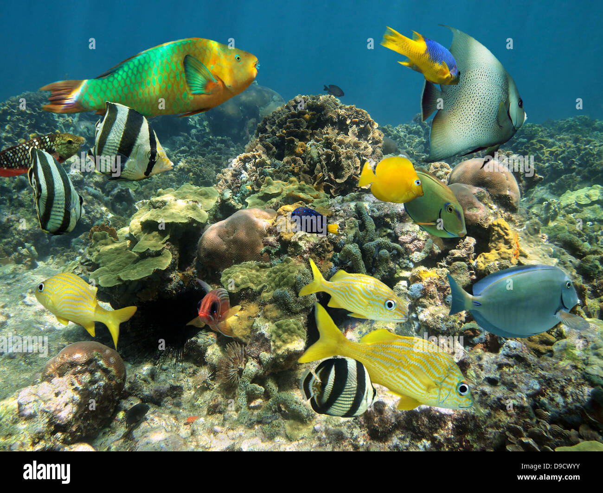
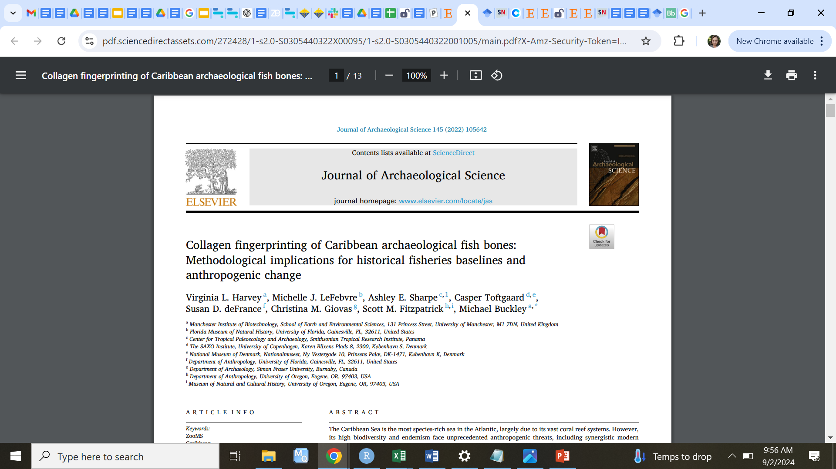
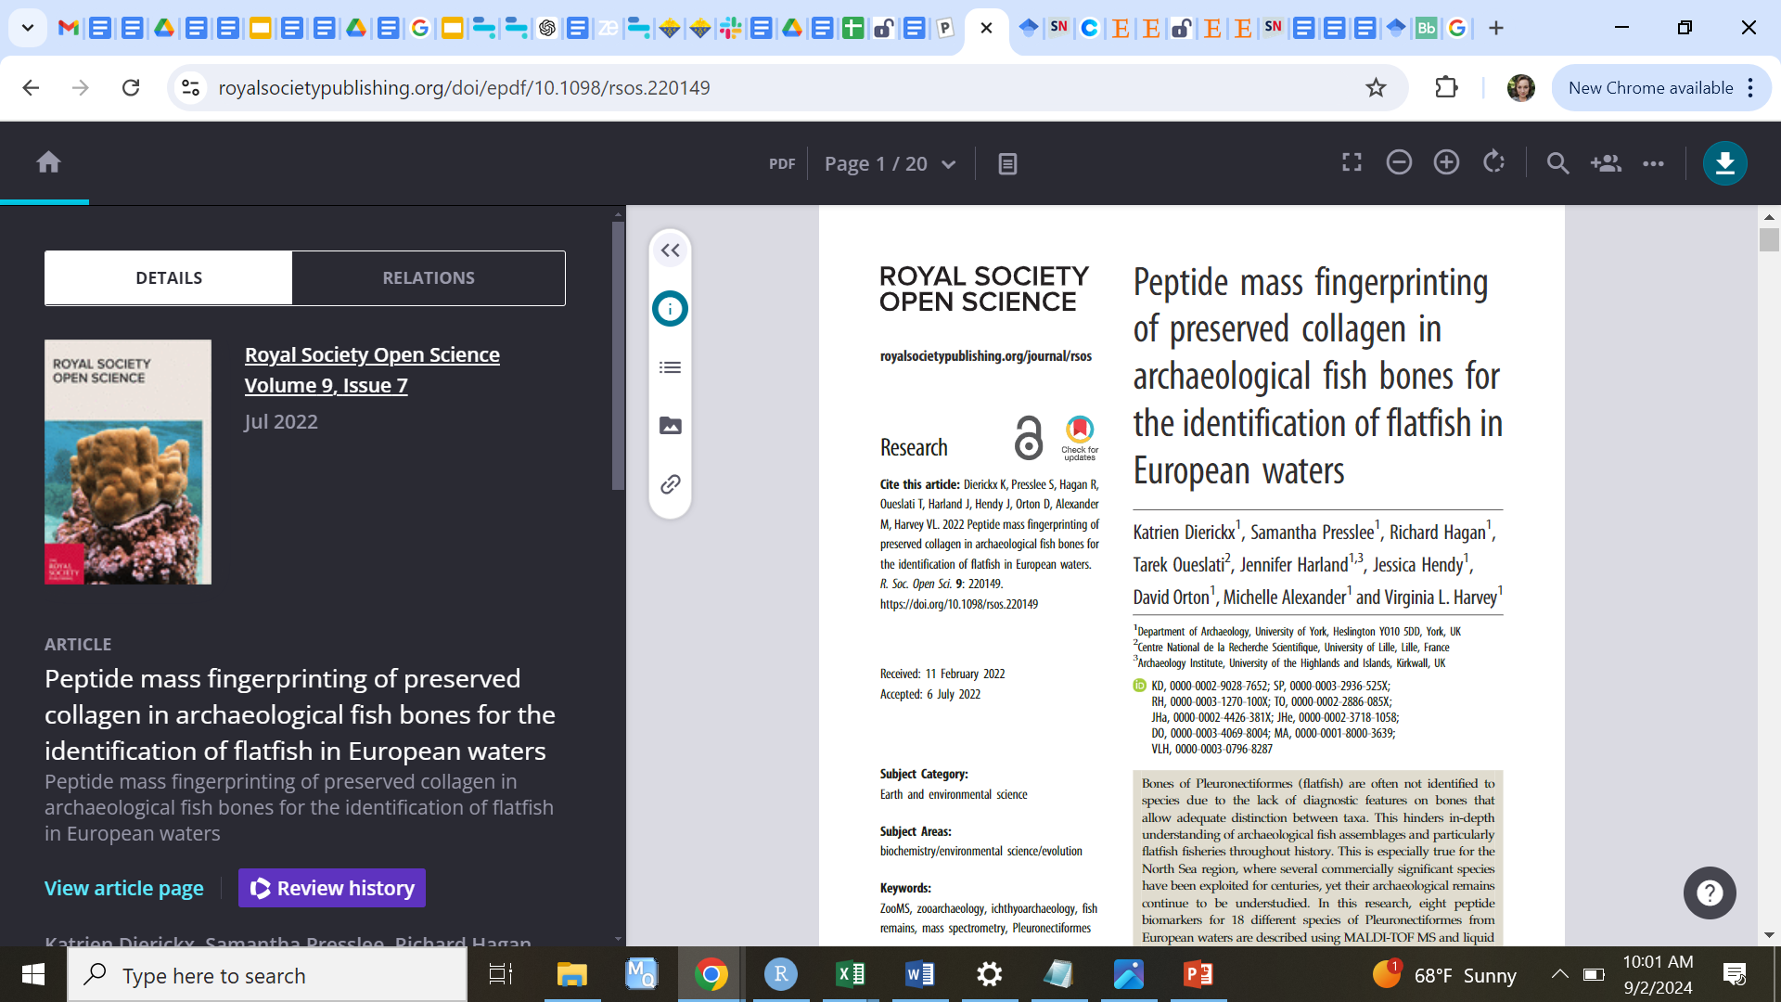
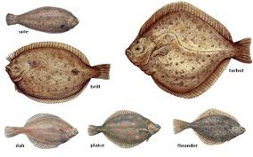
historic spawning grounds
baselines of ecosystem diversity
historic exploitation patterns

Slide 35
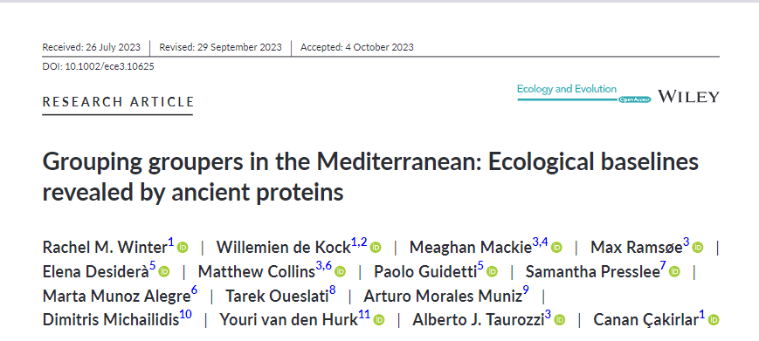
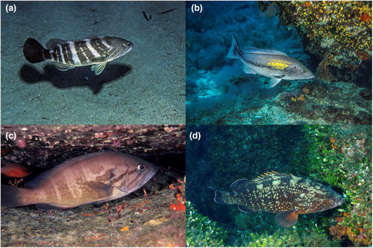
Long-term perspectives on species diversity
Revised growth capacity*
Historic species ranges
Improved phylogeny

Slide 36
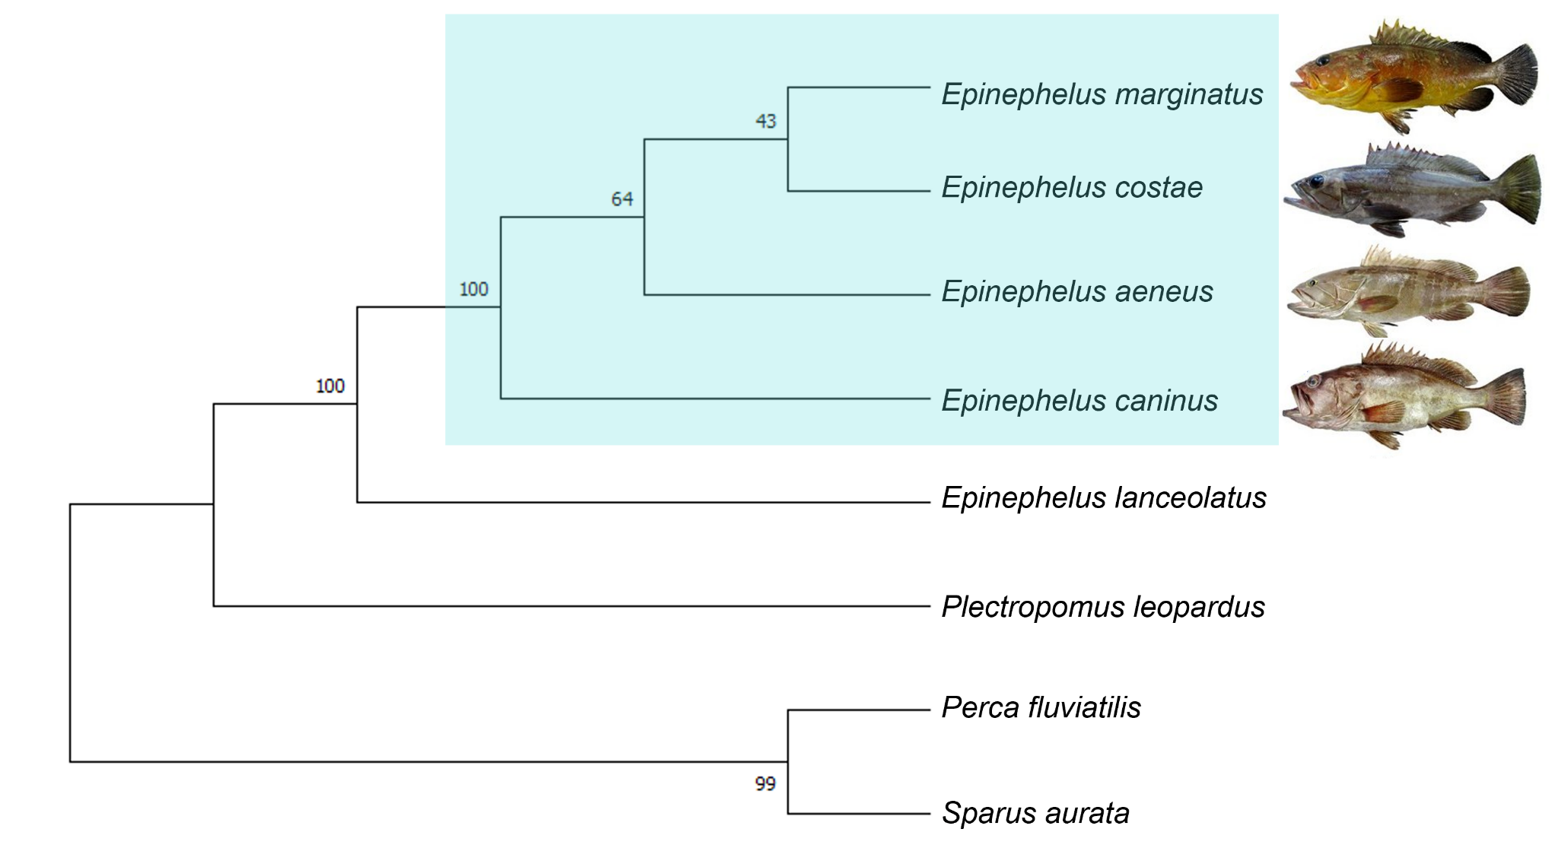
The evolutionary history was inferred by using the Maximum Likelihood method and General Reversible Mitochondrial + Freq. model (Adachi and Hasegawa 1996). The bootstrap consensus tree inferred from 10,000 replicates (Felsenstein 1985) is taken to represent the evolutionary history of the taxa analyzed. Branches corresponding to partitions reproduced in less than 50% bootstrap replicates are collapsed. The percentage of replicate trees in which the associated taxa clustered together in the bootstrap test 100 replicates are shown below the branches (Felsenstein 1985). Initial tree(s) for the heuristic search were obtained automatically by applying Neighbor-Join and BioNJ algorithms to a matrix of pairwise distances estimated using the JTT model, and then selecting the topology with superior log likelihood value. A discrete Gamma distribution was used to model evolutionary rate differences among sites (5 categories (+G, parameter = 0.3415)). This analysis involved 8 amino acid sequences. All positions with less than 25% site coverage were eliminated, i.e., fewer than 75% alignment gaps, missing data, and ambiguous bases were allowed at any position (partial deletion option). There were a total of 4251 positions in the final dataset. Evolutionary analyses were conducted in MEGA11 (Tamura, Stecher, and Kumar 2021). Mediterranean Epinephelus spp. images taken and modified from (Doğdu and Turan 2016). The highlighted turquoise box encompasses the four Epinephelus spp. indigenous to the Mediterranean Sea.
Winter et al. (2023)
Winter et al. (2023) Ecol. And Evol. 13(10), e10625.
Notes:
In process of testing this question, I manually reconstructed the COL1 chains for our four study species and in turn used that data to create the best supported phylogenetic tree for Mediterranean groupers to date – furthering our knowledge of taxonomic relations of lesser studied species
Winter, R. M., de Kock, W., Mackie, M., Ramsøe, M., Desiderà, E., Collins, M., Guidetti, P., Presslee, S., Alegre, M. M., Oueslati, T., Muniz, A. M., Michailidis, D., van den Hurk, Y., Taurozzi, A. J., & Çakirlar, C. (2023). Grouping groupers in the Mediterranean: Ecological baselines revealed by ancient proteins. Ecology and Evolution, 13(10), e10625.

Slide 37
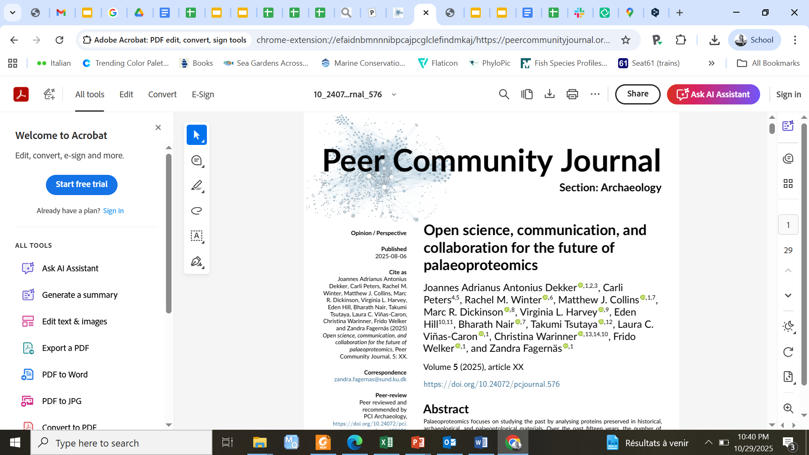









Elasmobrancheomics :
A working group focused on the application of palaeoproteomics to elasmobranchs.
Rachel M. Winter (University of Copenhagen), Matthew J. Collins (University of Copenhagen, Cambridge University), Virginia Harvey (University of Chester), Alexandra Burnett (Ghent University), Ian Engels (Ghent University), Synnøve Saugen (Ghent University), Jon Kennedy (Indiana University), Kristine Korzow Richter (Texas A&M University), Krista McGrath (Universitat Autònoma de Barcelona), Nayeli Jimenez Cano (University of California San Diego), Philippe Béarez (Muséum National d'Histoire Naturelle).

Slide 38
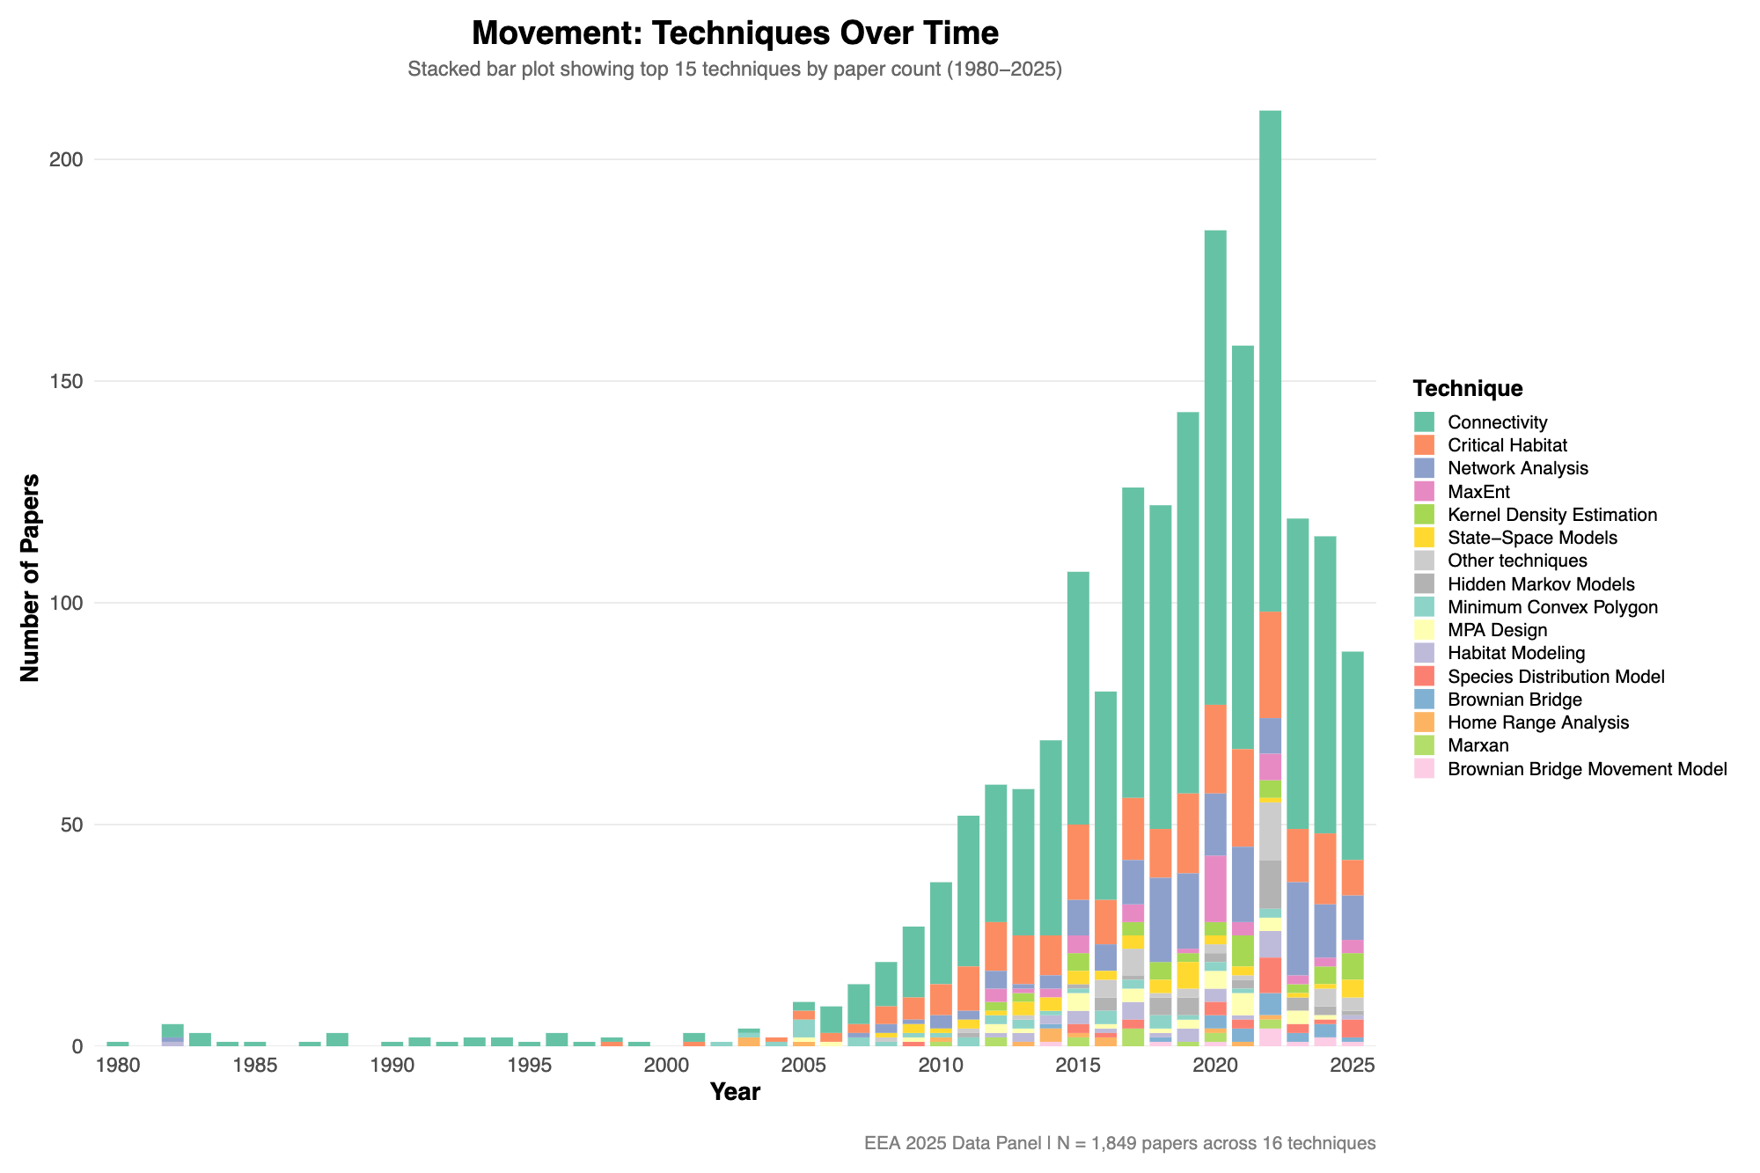
Movement, Space Use,
& Habitat Modeling
Presented by: Dr Ed Lavender & Professor Alen Soldo
Preliminary results!

Slide 39
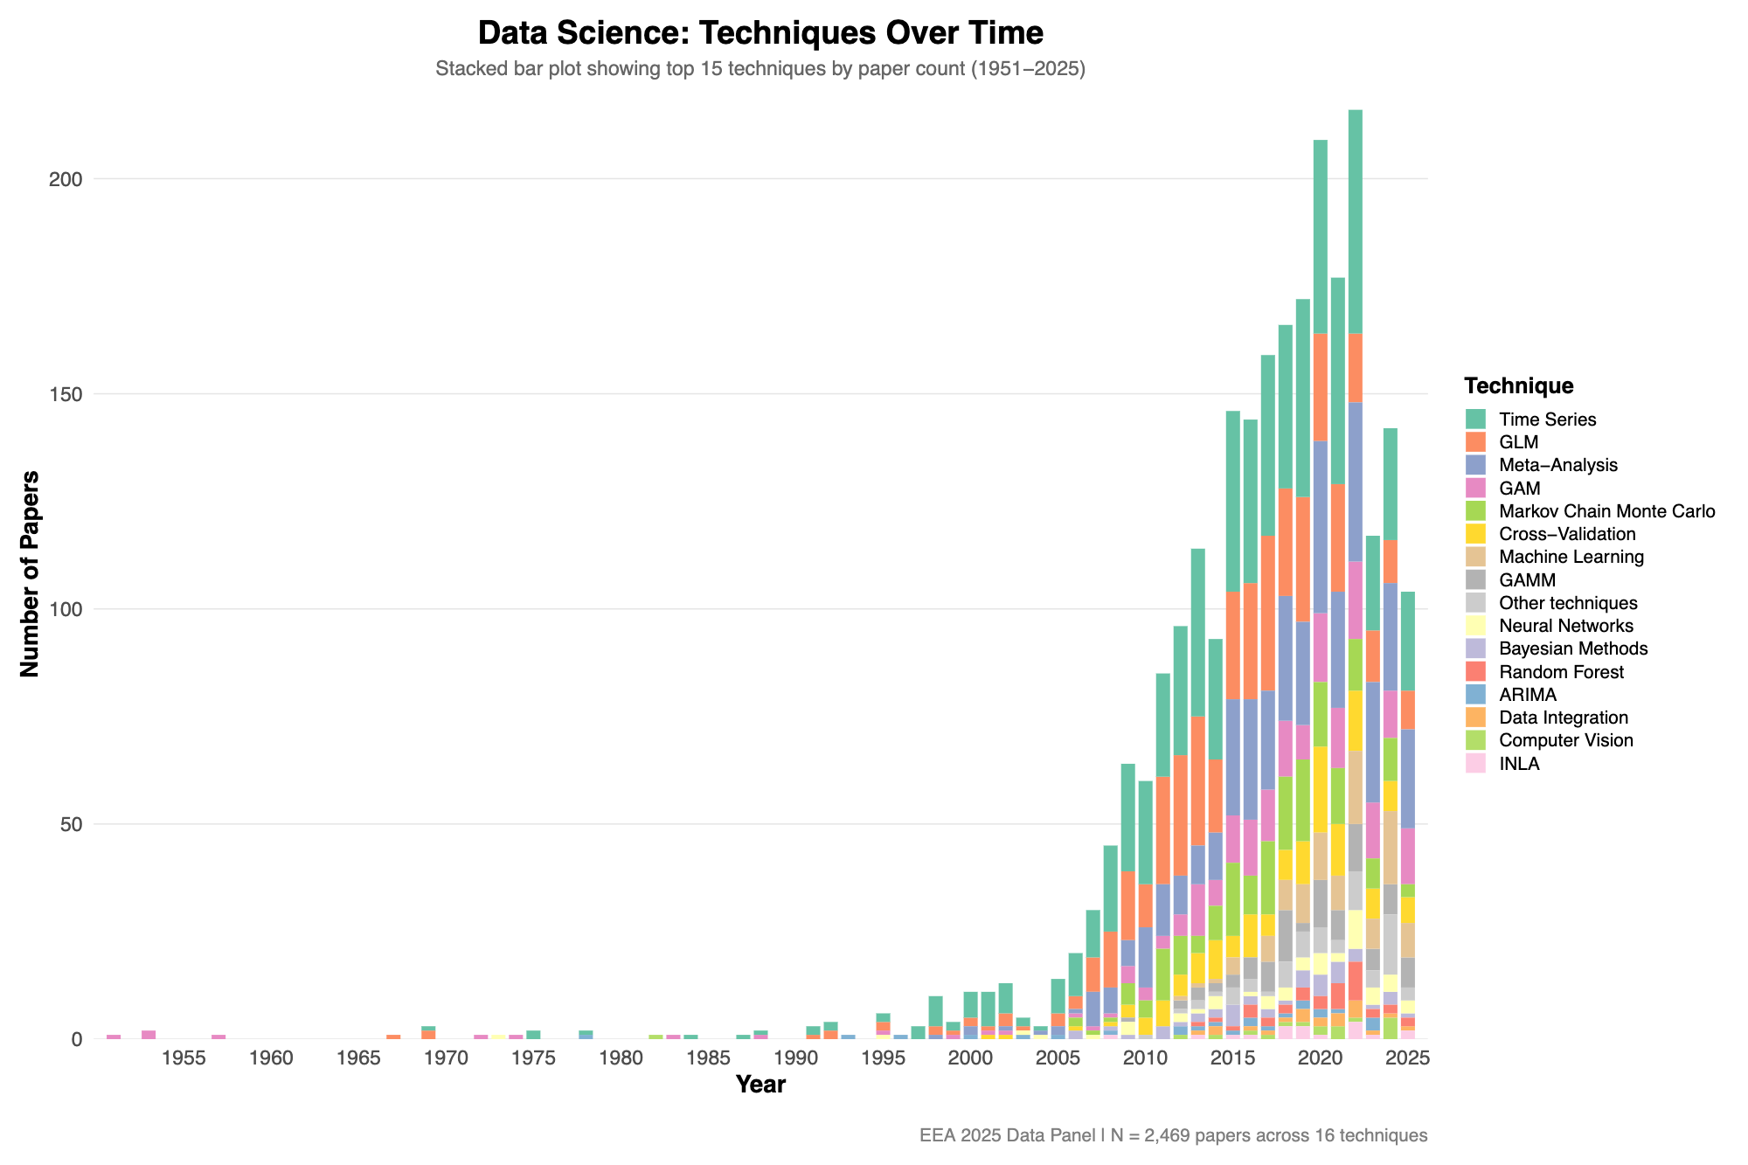
Data Science &
Integrative Methods
Presented by: Maria Lola Dolores Riesgo & Dr Simon Dedman
Preliminary results!
There has been an explosion of diversity in how we explore, analyse and treat data
However, in this “boom” era they are losers and winers

Slide 40


Data Science & Integrative Methods
Presented by: Maria Lola Dolores Riesgo & Dr Simon Dedman
All GLMs family members are dying and losing popularity…
RIGID METHODS, APPROACHES THAT DO NOT SCALE WITH BIG DATA
Machine Learning, Deep Learning, Bayesian Methods they are disrupting data science
SLOWLY IMPLEMENTATION IN ELASMOBRANCH STUDIES - ANALYSIS

Slide 41
Data Science & Integrative Methods
Presented by: Maria Dolores Riesgo & Dr Simon Dedman
WHY IS RENOVATION IN TECHNIQUES SLOW?
R struggle with dealing with Big Data and high-performance computing
Some ML/DL/AI operate as BLACK BOX
Lack of familiarity / training with Python or newer frameworks
Tradition and comfort with classical statistics: easier to understand and communicate
Data sparsity or complexity in elasmobranch research: harder to apply cutting-edge models
BUT:
... see data.table (w/ dplyr), duckdb, arrow, parquet, HPC connectors
... until you/someone looks into the box
5-10 year lag from novelty (resistance) to ubiquity (acceptance)
... but tag/enviromental/video data are here and growing: new frontier of ‘data drowned’

Slide 42
Data Science & Integrative Methods
Presented by: Maria Dolores Riesgo & Dr Simon Dedman
INTEGRATION TRADITIONAL WITH INNOVATION
Classical statistical analysis should be a complement, abandoning it is a mistake
Integration of classical and emerging methodologies is the key
Classical statistics remain our starting point and a common language for the interpretation and validation of new models

Slide 43
Data Science & Integrative Methods
Presented by: Maria Dolores Riesgo & Dr Simon Dedman
FUTURE FRONTIERS IN ELASMOBRANCH RESEARCH
A new generation of scientist is coming
More powerful computing power will become available
We must stay open to these technologies and methodologies, not to replace our current approach, but to expand it and solve the conservation challenges that still overwhelm us

Slide 44
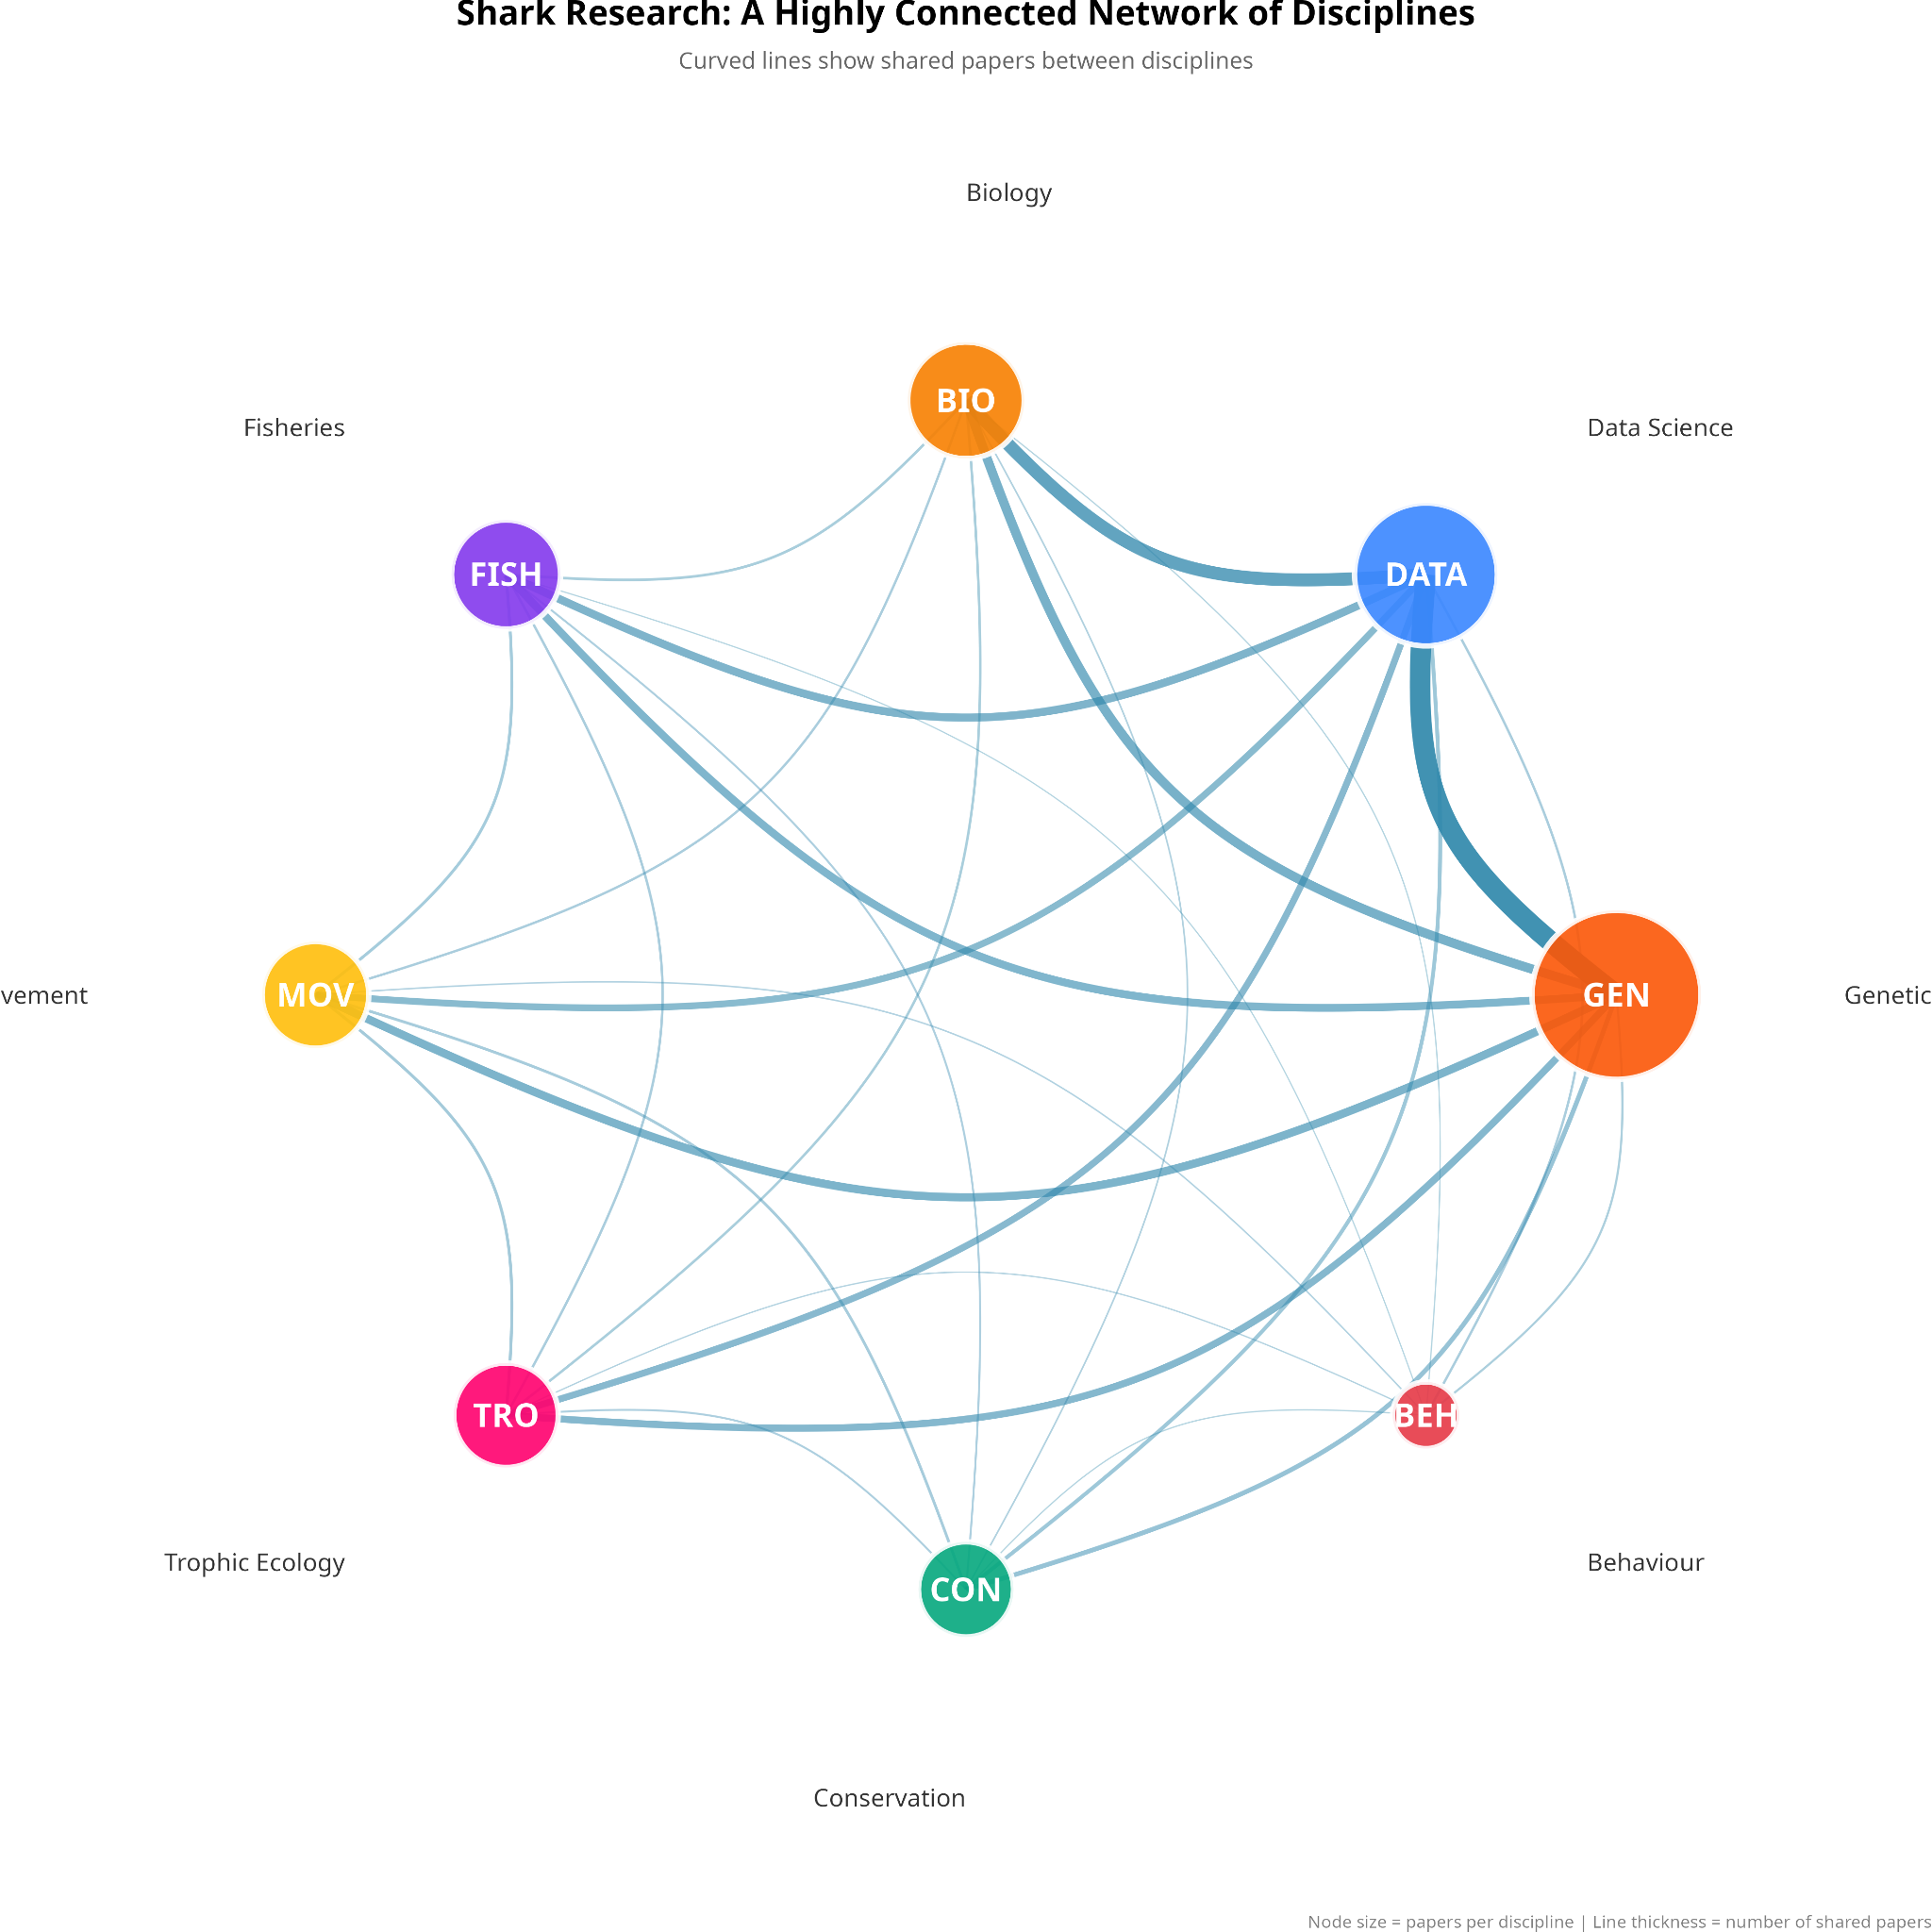
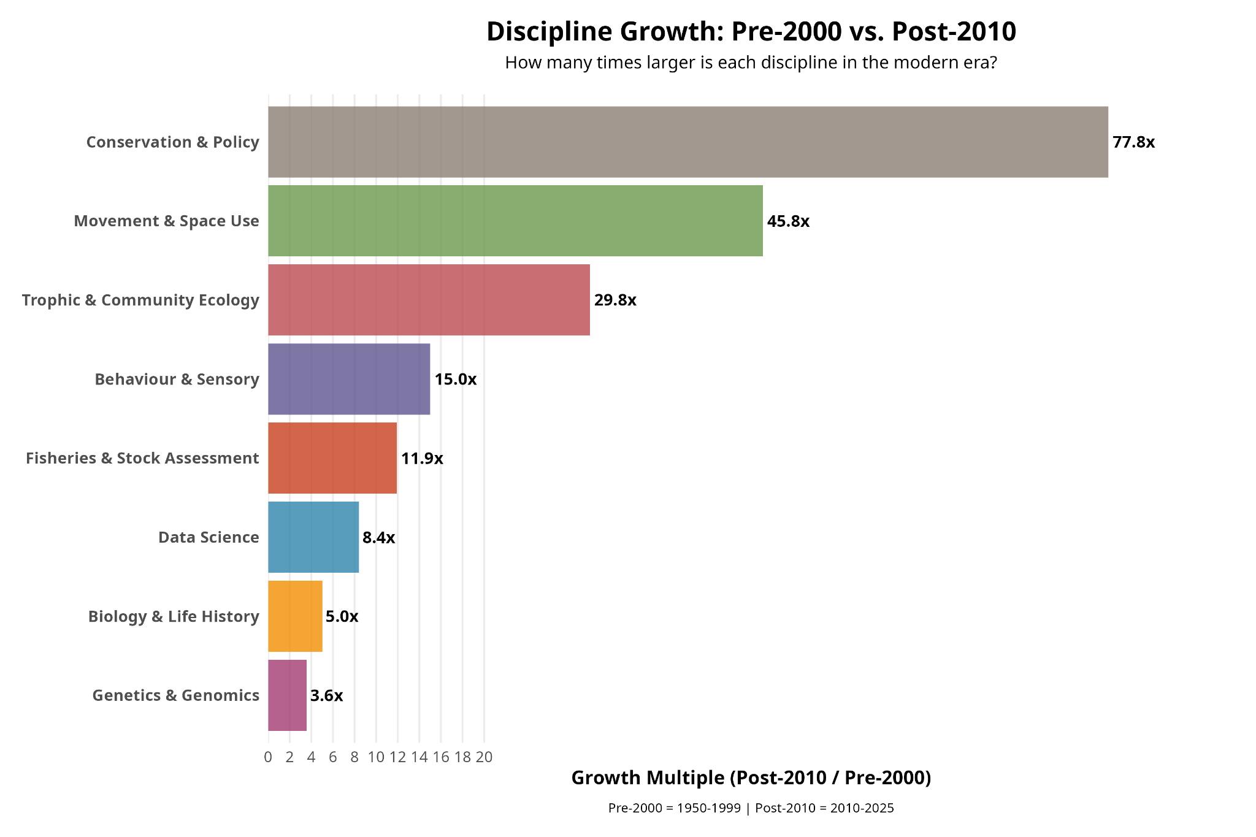
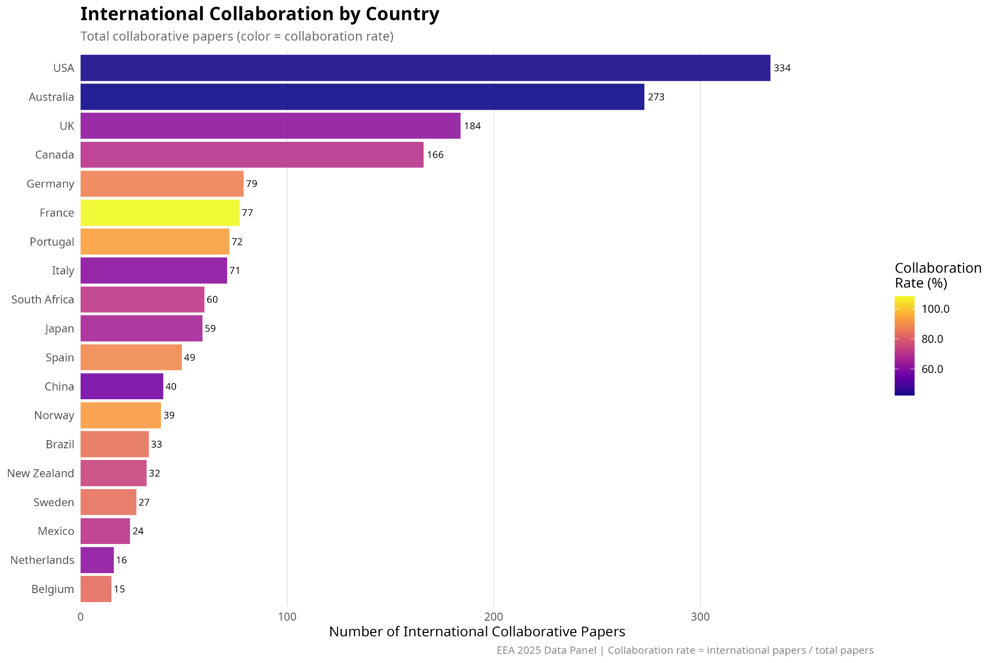
Panel
Session
Preliminary results!

Slide 45


Thank you for listening!
For any questions reach out to:
Dr Simon Dedman - simondedman@gmail.com (project lead)
Dr Guuske Tiktak - guusketiktak@gmail.com (co-lead)
If you’d like to read any of the work or contribute in any way, please follow this link & checkout our GitHub:
https://github.com/SimonDedman/elasmo_analyses

